Slide 1
v.0.0.1

Slide 2


Welcome to MLH Localhost:
Build Actions for Google Assistant
Sorry but you have to turn on your hotspots.
College ka to pata hi hai sbko
Event Hashtag:
#MLHLocalhost
Twitter Handle:
@MLHacks
Notes:
What to Edit:
Update this slide to include the wifi information.
What to Say:
Explain how to connect to the wifi.
Encourage participants to Post Photos on Facebook, Twitter or Intagram using #MLHLocalhost
What to Do:
Check that everyone is connected by asking the group to give you a signal if they are connected.

Slide 3


[Put your Photo Here]
Welcome! My name is
Jitendar Kumar
1
I’m here to lead this session & help you learn something new today!
2
I am 4th Year student from our college.
3
I am a Machine Learning extravegist and love to contribute to open source .
Notes:
What to Edit:
Add your name, photo, school info, and favorite programming tool or language.
What to Do:
Make attendees feel welcome by running a short Ice Breaker.
Go around the room and ask each person to answer the following questions:
Who are you?
What year are you in school and what is your major/field of study?
What is your favorite programming language or tool?
You should go first to demonstrate the exercise and introduce yourself

Slide 4
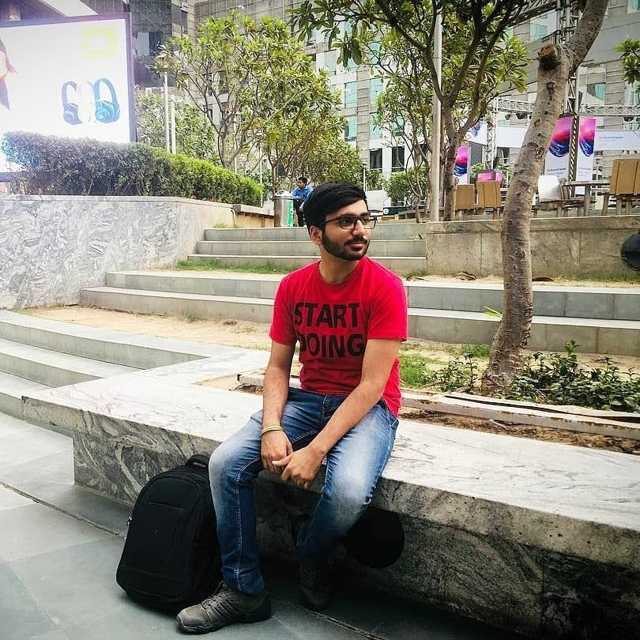
[Put your Photo Here]
Welcome! My name is
Loveneesh Dhir
1
I’m here to co-lead this session & help you learn something new today!
2
I am currently working on ML.
3
I love community building and going to launch OSDC- Delhi in a few days.
Notes:
What to Edit:
Add your name, photo, school info, and favorite programming tool or language.
What to Do:
Make attendees feel welcome by running a short Ice Breaker.
Go around the room and ask each person to answer the following questions:
Who are you?
What year are you in school and what is your major/field of study?
What is your favorite programming language or tool?
You should go first to demonstrate the exercise and introduce yourself

Slide 5

Our Mission is to Empower Hackers.
65,000+
HACKERS
12,000+
PROJECTS CREATED
3,000+
SCHOOLS
We hope you learn something awesome today!
Find more resources: http://mlh.io/
Notes:
What to Say:
Major League Hacking (MLH) events are meant to bring hackers together so they can learn, build, and share.
Give participants a brief overview of Major League Hacking (MLH).
Tell participants they can learn more at http://mlh.io/
Example Talking Points:
TODO
Through Localhost MLH is rethinking technology education to reflect how hackers actually learn and how fast the industry moves.
Here’s some quick facts about MLH:
Each year, MLH supports over 65,000 hackers around the world at events they facilitate
Those students create more than 12,000 amazing projects together
MLH is a global organization that empowers hackers in more than 400 cities and growing every day

Slide 6
Hey! You need the codebase for this workshop and a promo code to sign up for Google Cloud Platform without a credit card!
To receive the codebase and the promo code, fill out the form that is linked below.
You'll receive two emails - one with the promo code, and one with the workshop instructions. Keep these handy!
http://mlhlocal.host/checkin
Notes:
What to Say:
Tell attendees we are going to check them in for the event
Once attendees checkin, they will receive an email with the items listed on the slide
Attendees must checkin to get credit for attending this event
What to Do:
Confirm that everyone has checked in by asking participants to give you a signal when they receive the email.

Slide 7
What will you learn today?
1
Understand Voice User Interfaces & what you can build using them.
Become familiar with Google Cloud Platform
2
3
How to combine several Google APIs and services to create awesome Actions
Notes:
What to Say:
Explain to participants what they will learn today
Learning is a core part of being a hacker and today they are going to learn something new
What to Do:
Get participants excited about the experience.

Slide 8
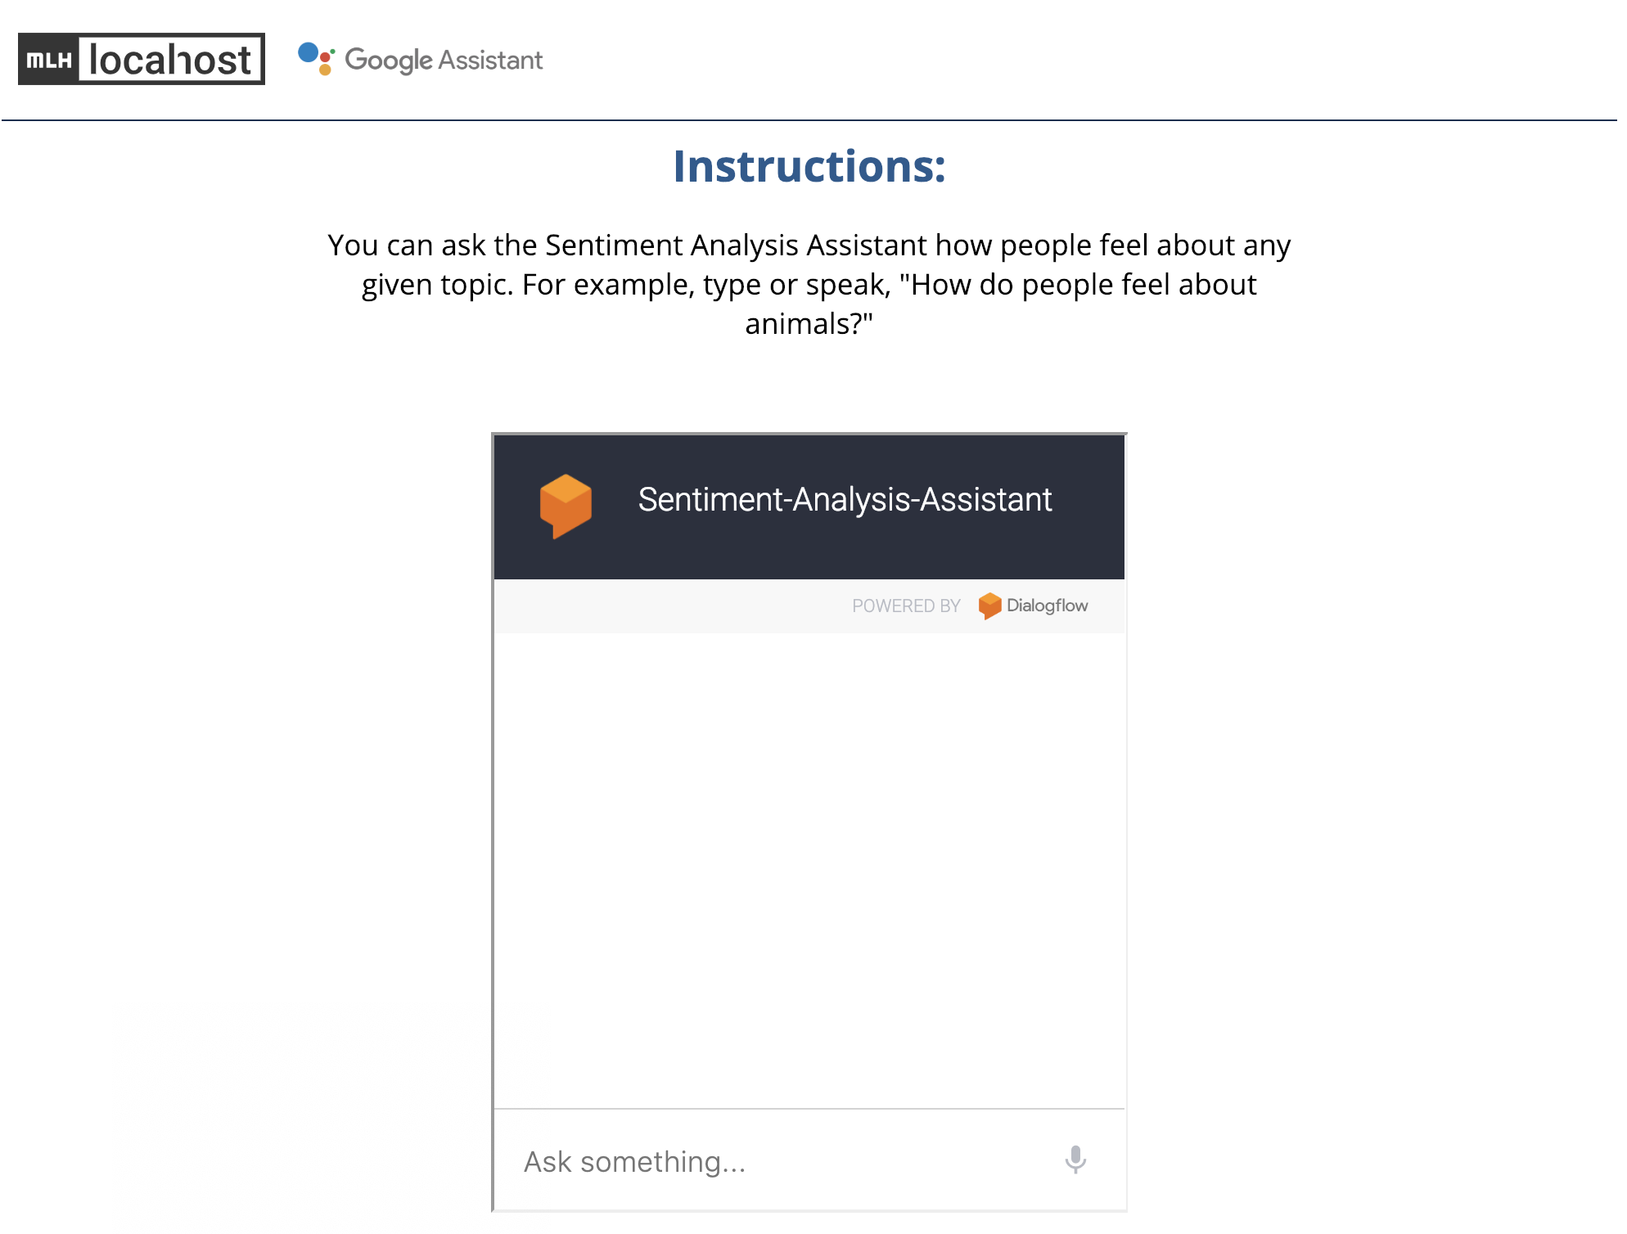
What are you going to be building today?
http://mlhlocal.host/google-demo
Notes:
What to Say:
Explain to participants what they will learn today
Learning is a core part of being a hacker and today they are going to learn something new
What to Do:
Get participants excited about the experience.

Slide 9

How did that work?
You spoke or typed a query into a Dialogflow widget.
That query was submitted as a request to an Action on Google, a type of application for Google Assistant.
The Action sent a request to the Twitter API to retrieve Tweets about the subject.
The Action then submitted the response from the Twitter API (Tweets about the query) to the Google Cloud Natural Language API which ran sentiment analysis to determine how people feel about the subject you entered.
The app received the response from the NLP API and replied through the Dialogflow widget!
Notes:
What to Say:
Explain to participants what they will learn today
Learning is a core part of being a hacker and today they are going to learn something new
What to Do:
Get participants excited about the experience.

Slide 10
Part of being a developer is learning how to pick the right tools for the job, and how to put them together.
What tools are we going to use to recreate the Action you tried?
Notes:
What to Say:
Read the slide.

Slide 11

What tools are we going to use?
JavaScript
Google Cloud Platform
The Twitter API
A programming language used for many different types of apps
A set of tools and services for creating applications that are connected to the web
Twitter’s developer platform that allows programmatic interactions with Twitter
Actions on Google
Dialogflow
A Google service that enables you to create Actions for Google Assistant
A Google service that enables you to easily create conversational interfaces for your Actions
Notes:
What to Say:
Explain to participants what they will learn today
Learning is a core part of being a hacker and today they are going to learn something new
What to Do:
Get participants excited about the experience.

Slide 12

What are you going to do?
These are the steps you'll need to take to recreate the Action you tried:
Create a Google Cloud Platform account.
Enable the Natural Language Processing API.
Create an Actions on Google project.
Build an intent with Dialogflow.
Create a Twitter Dev account so your Action can use the Twitter API.
Add your credentials to the code for the project.
Test it out!
Notes:
What to Say:
Explain to participants what they will learn today
Learning is a core part of being a hacker and today they are going to learn something new
What to Do:
Get participants excited about the experience.

Slide 13
Let's get started!
Notes:
What to Say:
Read the slide.

Slide 15
To complete this workshop, you will need a Google account. If you don't have a Google account, go to mlhlocal.host/google-account and create one!
Note: If your Google account is through a school, it is advisable to use a personal Google account as some schools do not enable Cloud Console (which you'll need!)
Notes:
What to Say:
Read the slide.

Slide 16

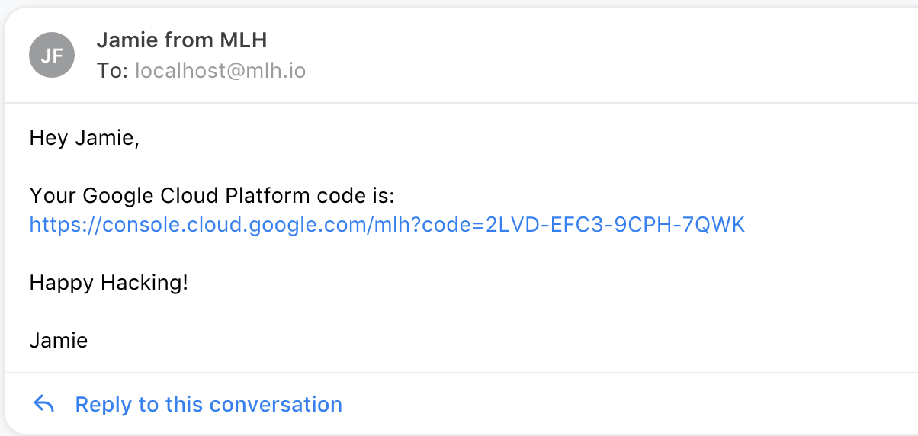
Google Cloud Platform Account
Make sure you are logged into your Google account.
Click the Google Cloud Platform Promo Credit from your email!
Notes:
What to Say:
Explain to participants what they will learn today
Learning is a core part of being a hacker and today they are going to learn something new
What to Do:
Get participants excited about the experience.

Slide 17
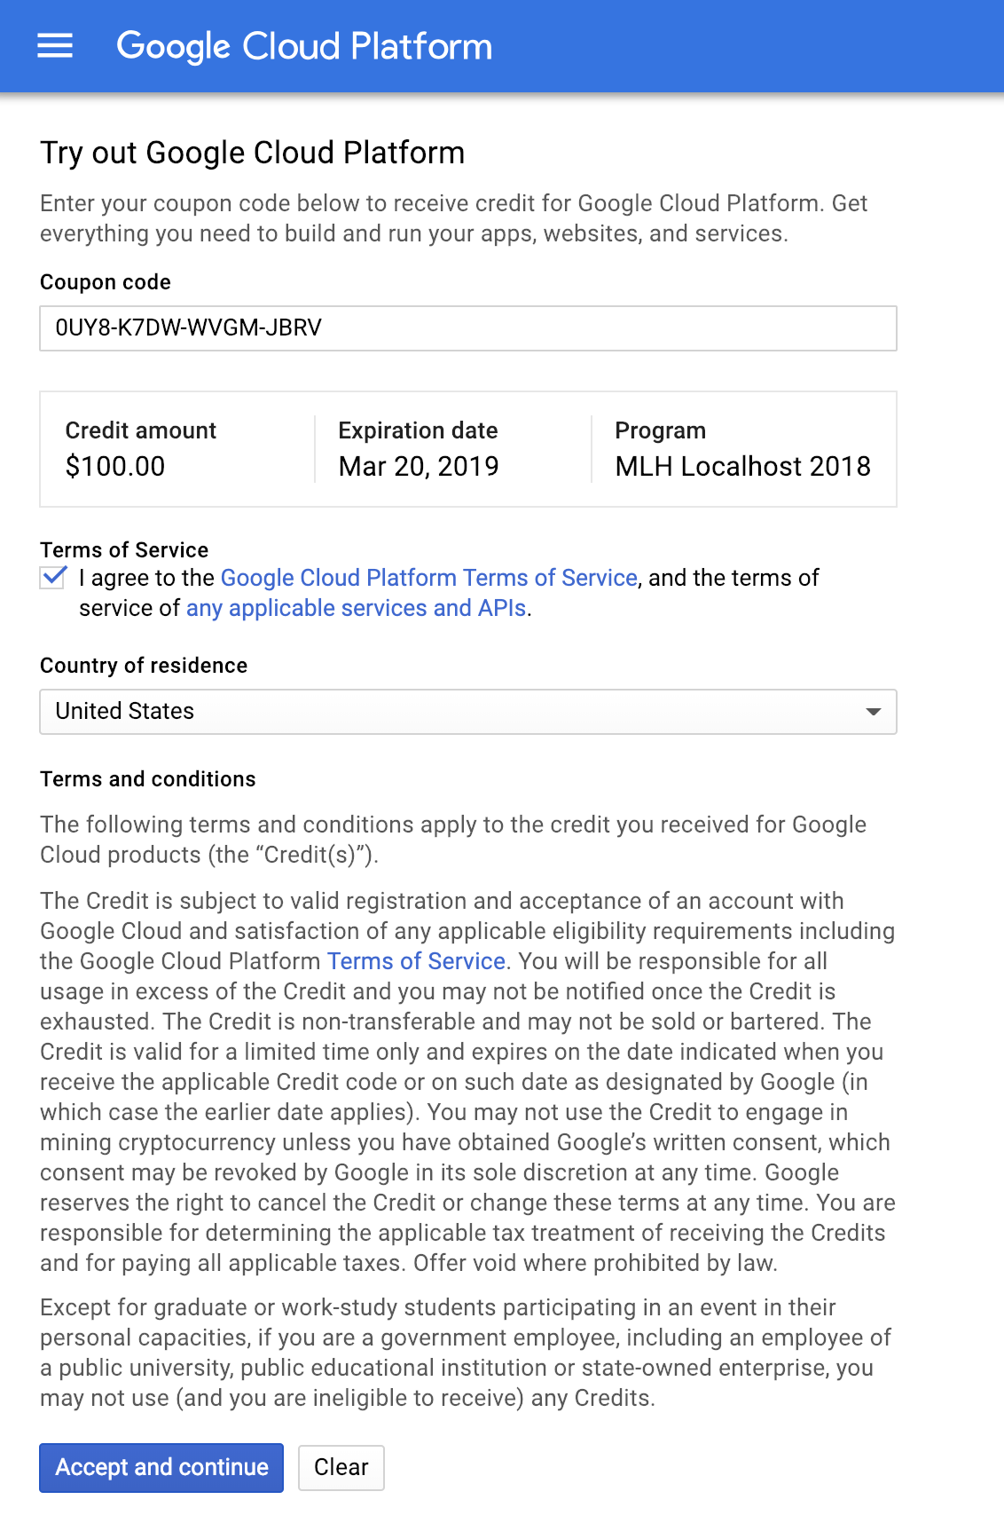
Google Cloud Platform Account
Read the terms. If you agree, check the Terms of Service box. Then, select Accept and continue. Note: Do NOT activate the $300 in promo credit. That will require you to use a credit card!
Notes:
What to Say:
Explain to participants what they will learn today
Learning is a core part of being a hacker and today they are going to learn something new
What to Do:
Get participants excited about the experience.

Slide 18
Great! You now have a Google Cloud Platform account!
Let's create your first project.
Notes:
What to Say:
Read the slide.

Slide 19
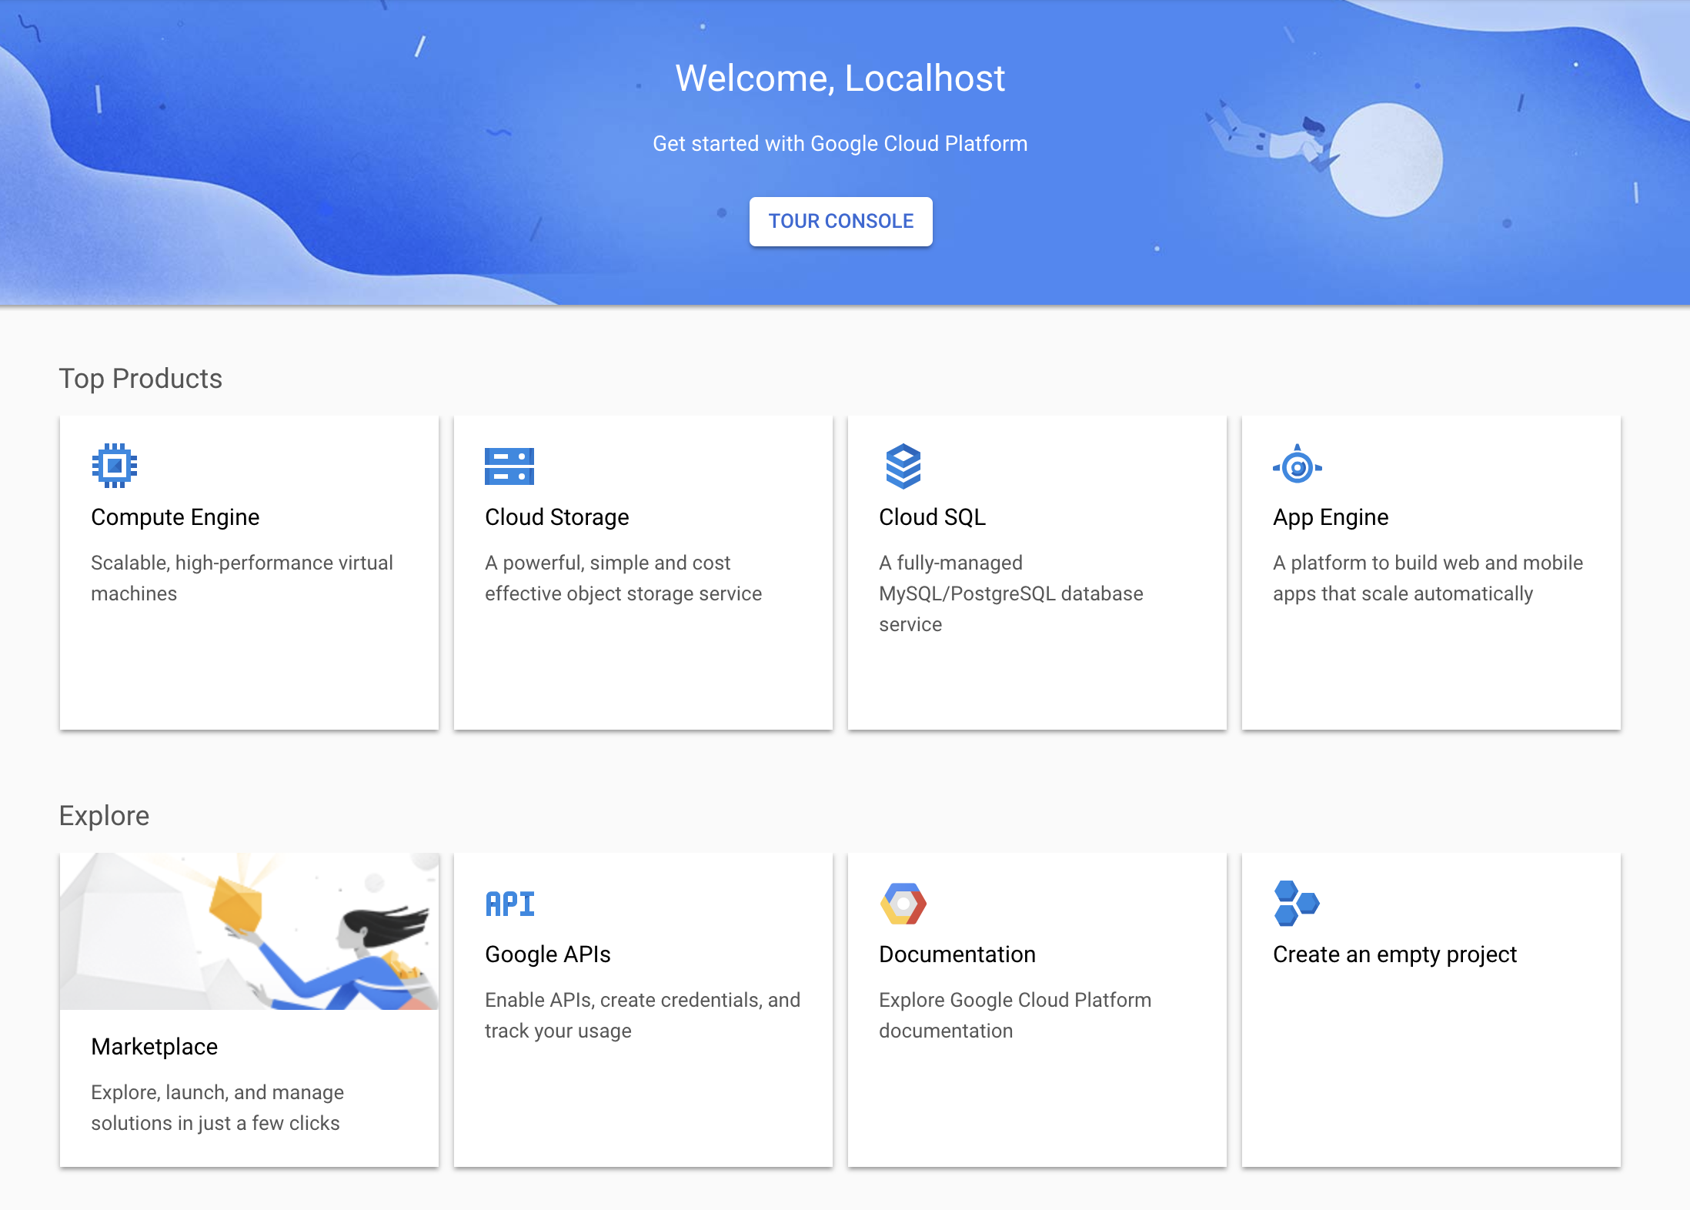
Google Cloud Platform Project
After the previous step, you should have been redirected to the screen below. If you see this screen, select Create an empty project.
If you don't see this screen, navigate to mlhlocal.host/new-gcp-project and click Create a Project.
Notes:
What to Say:
Explain to participants what they will learn today
Learning is a core part of being a hacker and today they are going to learn something new
What to Do:
Get participants excited about the experience.

Slide 20
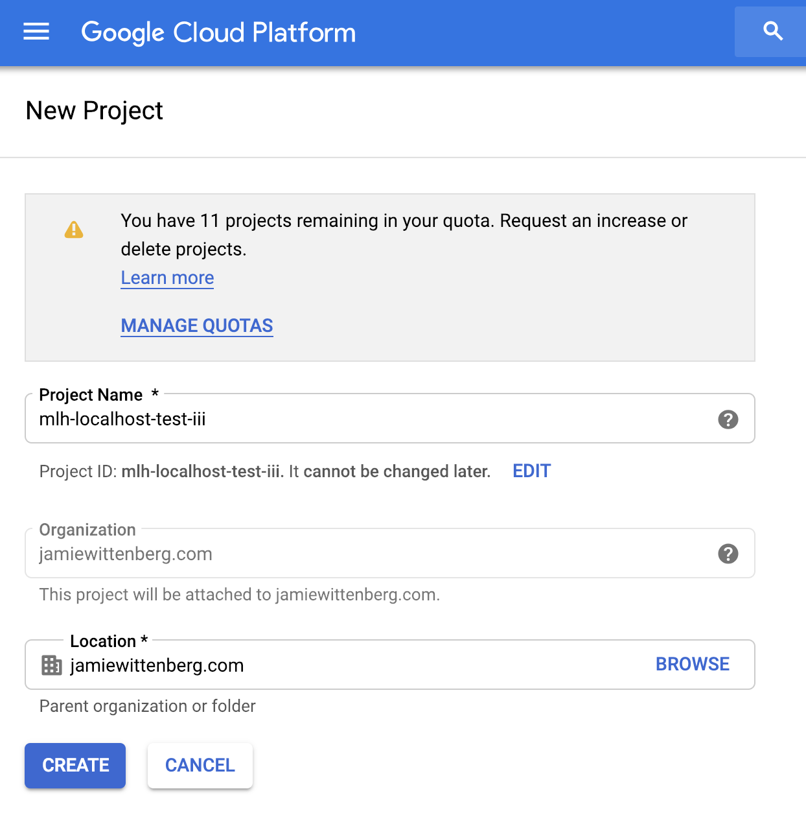
Google Cloud Platform Project
Name your project.
Select CREATE.
Note: Refresh the page if you have any errors here.
Notes:
What to Say:
Explain to participants what they will learn today
Learning is a core part of being a hacker and today they are going to learn something new
What to Do:
Get participants excited about the experience.

Slide 21
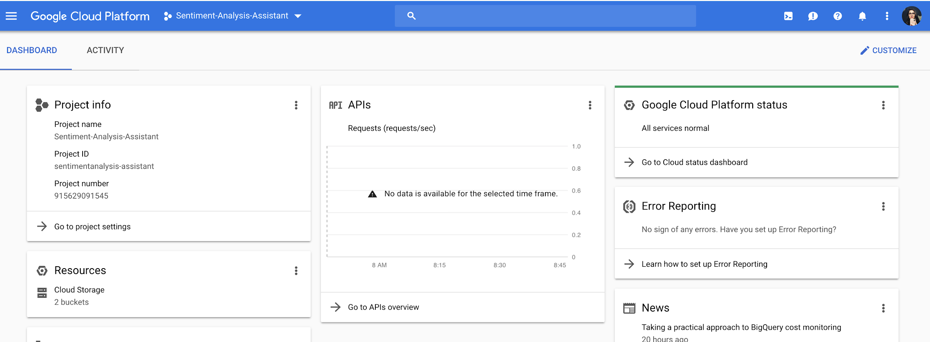
Google Cloud Platform Console Overview
Once your project is created, you will be redirected to the console. Google Cloud Platform provides many services for developers. Today, you're going to focus on the top left.
Notes:
What to Say:
Explain to participants what they will learn today
Learning is a core part of being a hacker and today they are going to learn something new
What to Do:
Get participants excited about the experience.

Slide 22
Google Cloud Platform Console Overview
Make sure the project selected is the one you just created. If it says "My First Project," that is incorrect. Switch projects.
Notes:
What to Say:
Explain to participants what they will learn today
Learning is a core part of being a hacker and today they are going to learn something new
What to Do:
Get participants excited about the experience.

Slide 23
This project is going to use the Natural Language Processing API. We need to enable it!
Notes:
What to Say:
Read the slide.

Slide 24
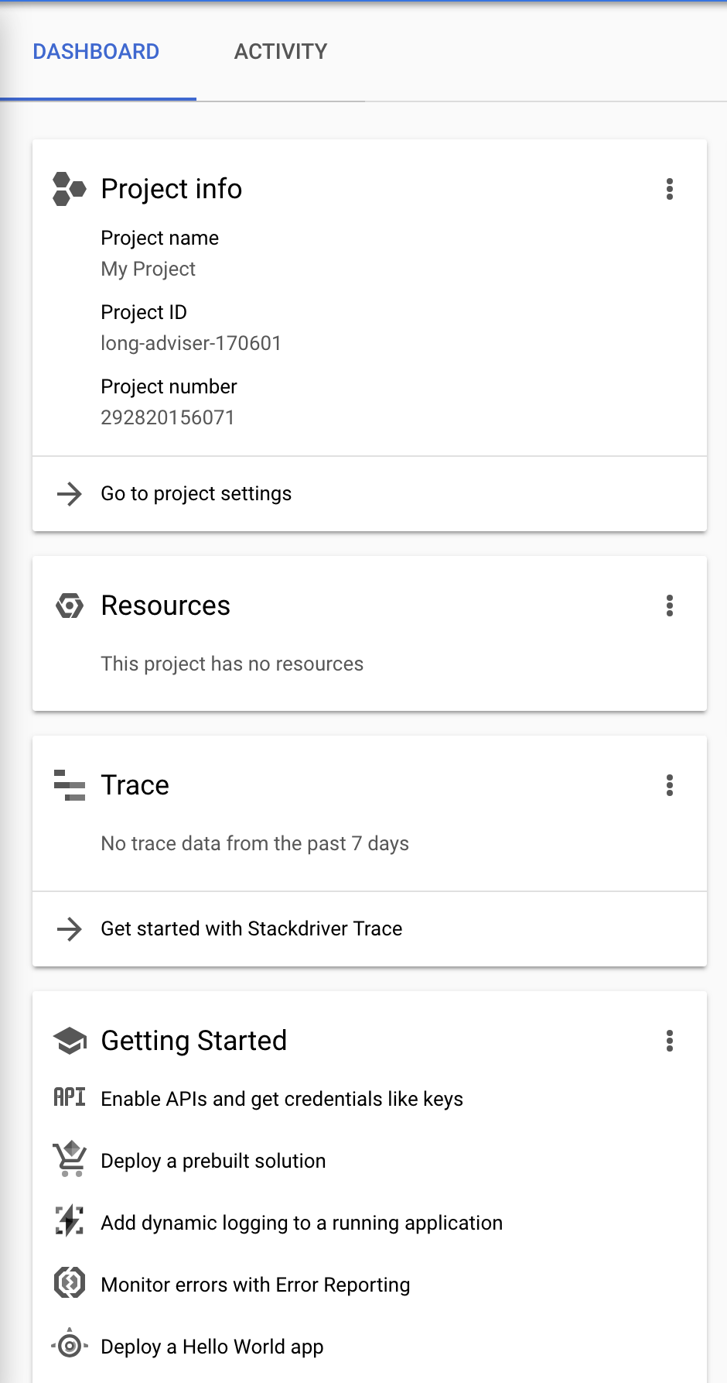
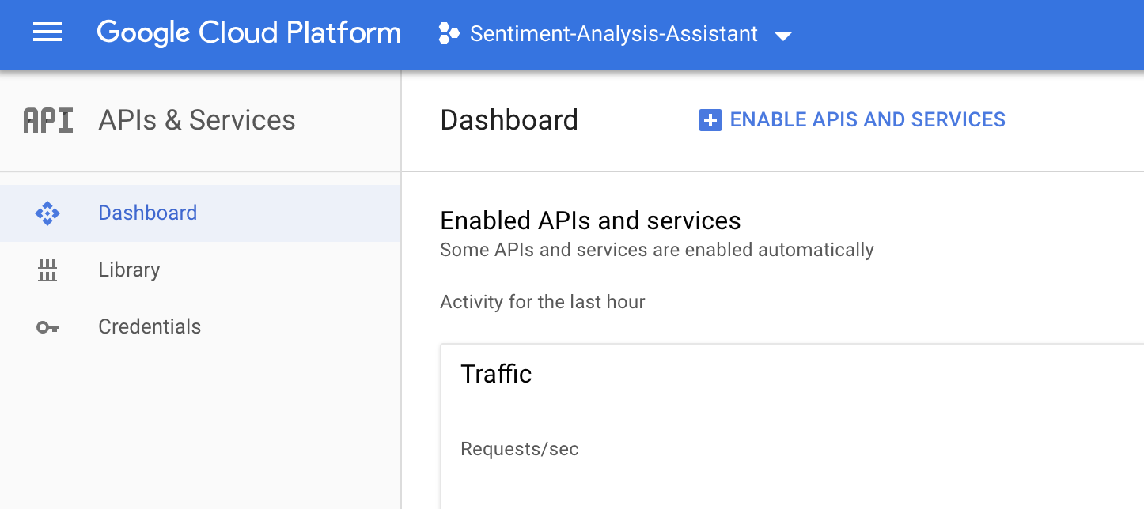
Cloud Natural Language API
Under Getting Started, select Enable APIs and get credentials like keys.
Select ENABLE APIS AND SERVICES.
Notes:
What to Say:
Explain to participants what they will learn today
Learning is a core part of being a hacker and today they are going to learn something new
What to Do:
Get participants excited about the experience.

Slide 25
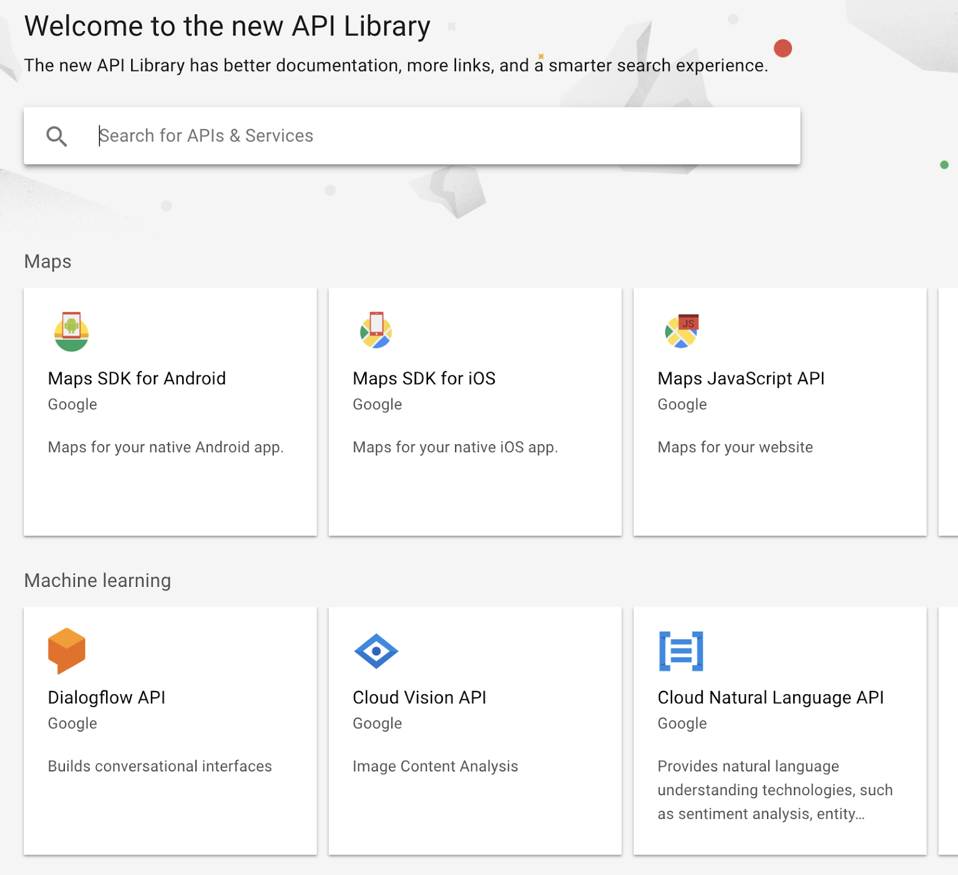
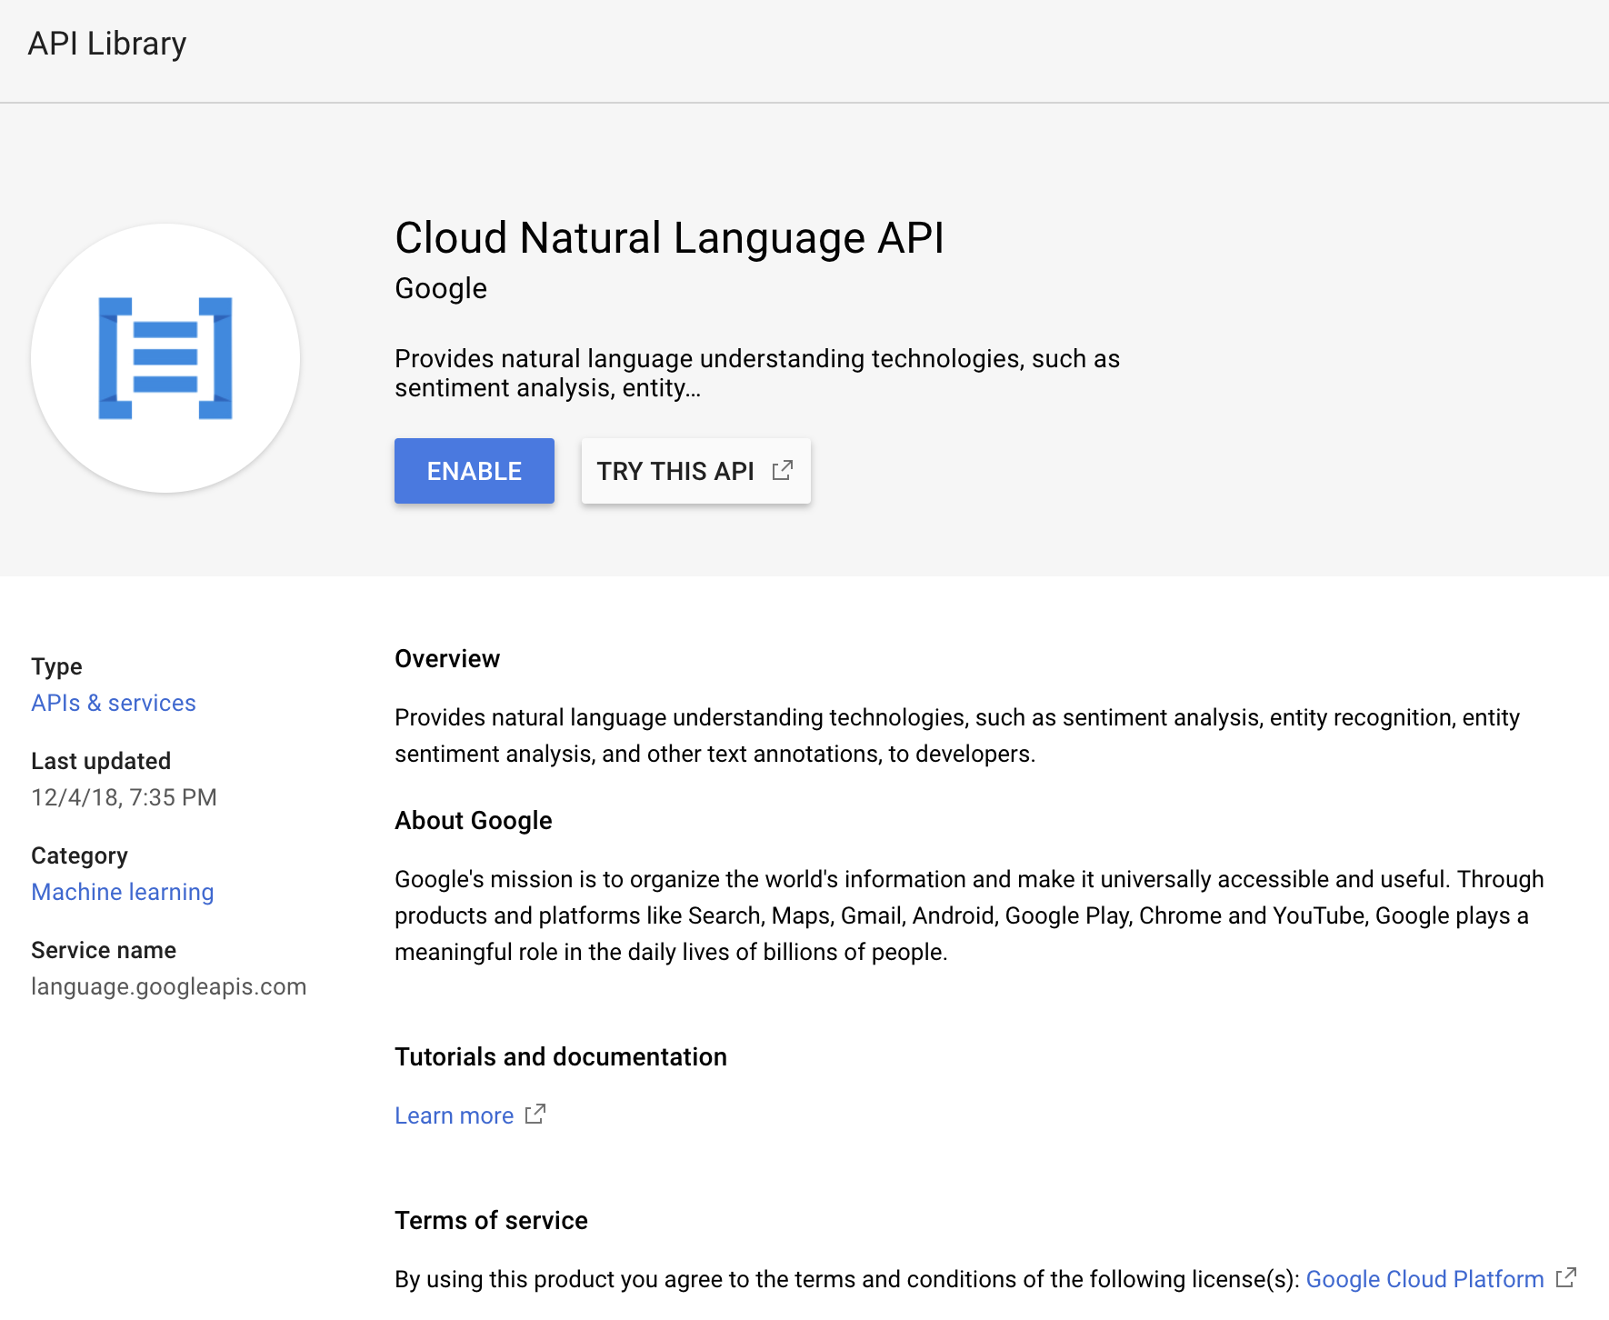
Cloud Natural Language API
Search for or select Cloud Natural Language API. Select ENABLE on the next screen.
Notes:
What to Say:
Explain to participants what they will learn today
Learning is a core part of being a hacker and today they are going to learn something new
What to Do:
Get participants excited about the experience.

Slide 26
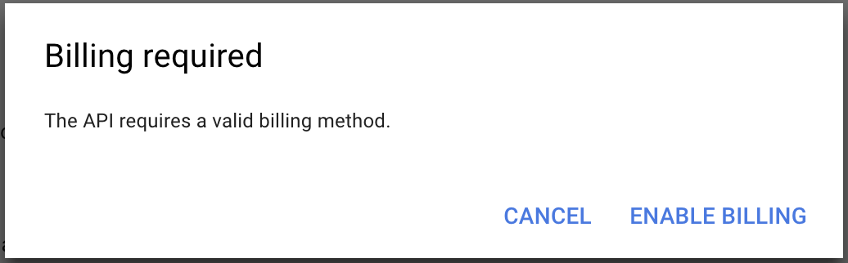
Cloud Natural Language API
If you see this modal, select ENABLE BILLING. You won't be charged anything, but you need to tell Google Cloud Platform to link this API to your payment method.
Notes:
What to Say:
Explain to participants what they will learn today
Learning is a core part of being a hacker and today they are going to learn something new
What to Do:
Get participants excited about the experience.

Slide 27
Great! Now your project can use the Google Cloud Natural Language API. Actions on Google is the platform to develop for Google Assistant. Let's set that up!
Notes:
What to Say:
Read the slide.

Slide 29
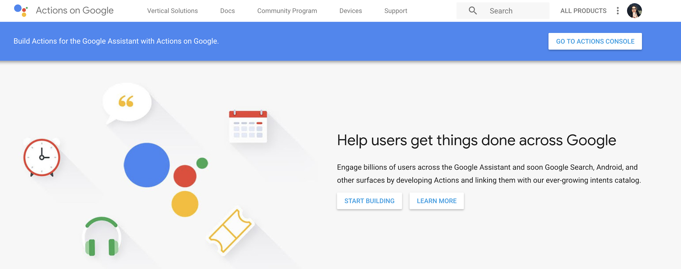
Actions on Google Console
http://mlhlocal.host/google-actions
In a new tab, navigate to the URL above.
Select GO TO ACTIONS CONSOLE.
Notes:
What to Say:
Explain to participants what they will learn today
Learning is a core part of being a hacker and today they are going to learn something new
What to Do:
Get participants excited about the experience.

Slide 30
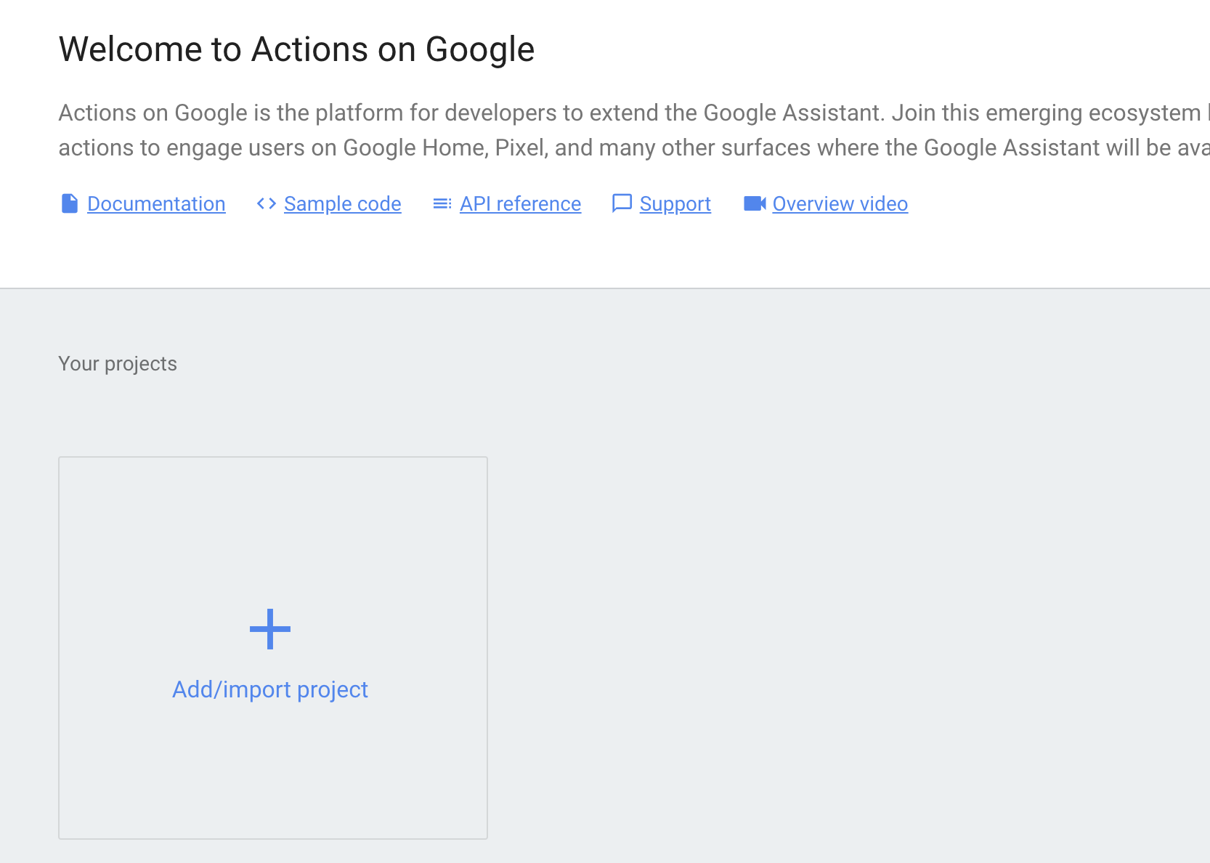
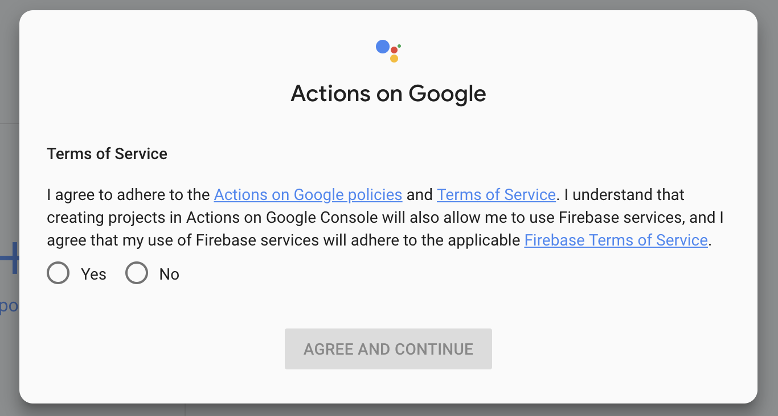
Actions on Google Console
Select Add/import project.
Read the terms and select Yes if you agree, then AGREE AND CONTINUE.
Notes:
What to Say:
Explain to participants what they will learn today
Learning is a core part of being a hacker and today they are going to learn something new
What to Do:
Get participants excited about the experience.

Slide 31
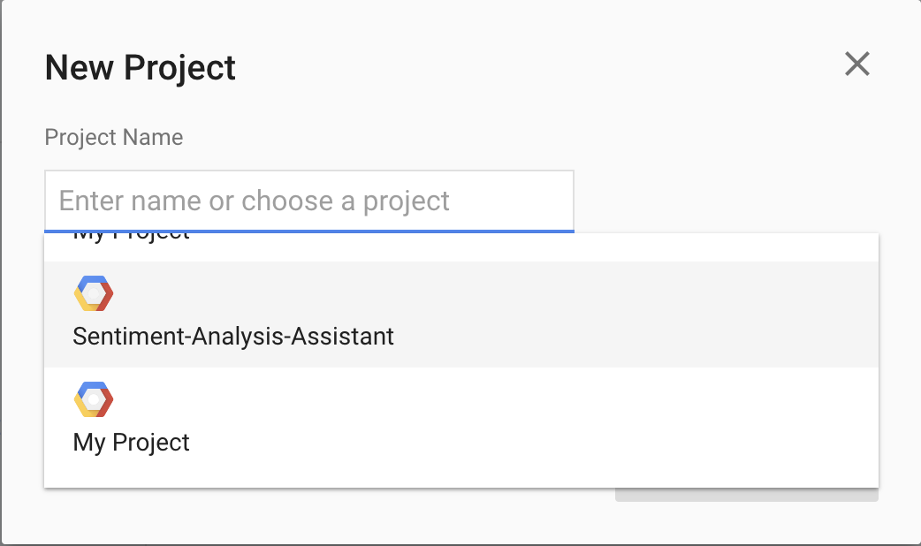
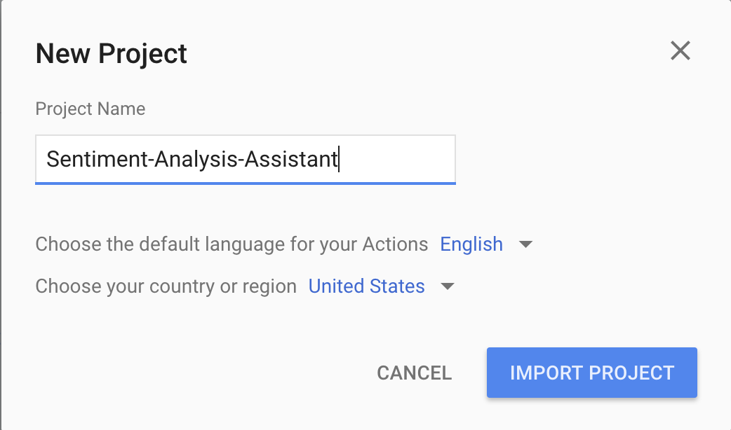
Actions on Google Console
Click the search box and scroll until you find your project.
Select your project, then click IMPORT PROJECT.
Notes:
What to Say:
Explain to participants what they will learn today
Learning is a core part of being a hacker and today they are going to learn something new
What to Do:
Get participants excited about the experience.

Slide 32
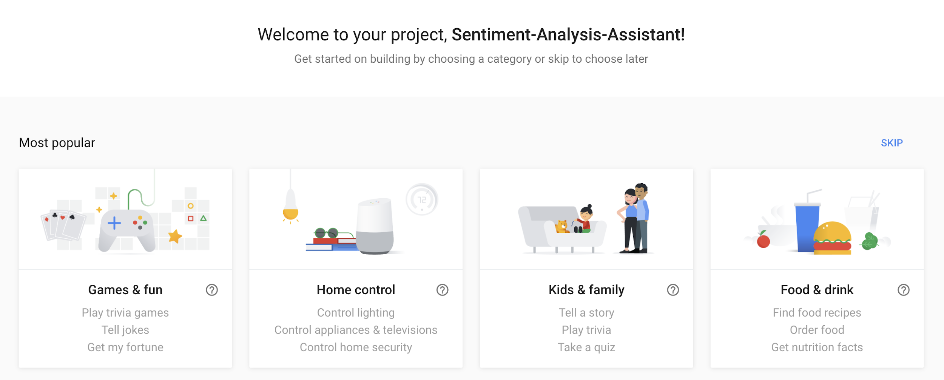
Actions on Google Console
Scroll down to the More Options section and click on the Conversational card.
Notes:
What to Say:
Explain to participants what they will learn today
Learning is a core part of being a hacker and today they are going to learn something new
What to Do:
Get participants excited about the experience.

Slide 33
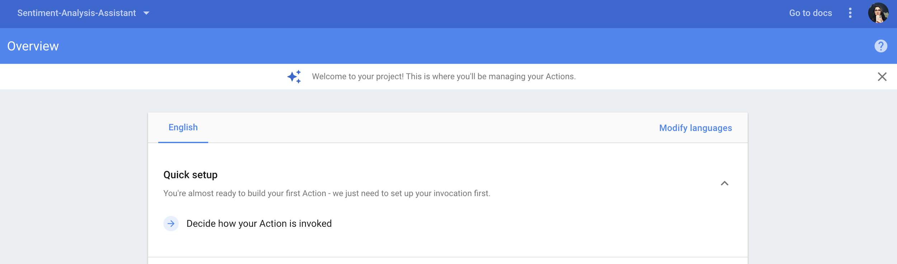
Actions on Google Console
Select Decide how your Action is invoked.
Key Term
Invocation: What a user says to Google Assistant to open your Action.
Notes:
What to Say:
Explain to participants what they will learn today
Learning is a core part of being a hacker and today they are going to learn something new
What to Do:
Get participants excited about the experience.

Slide 34
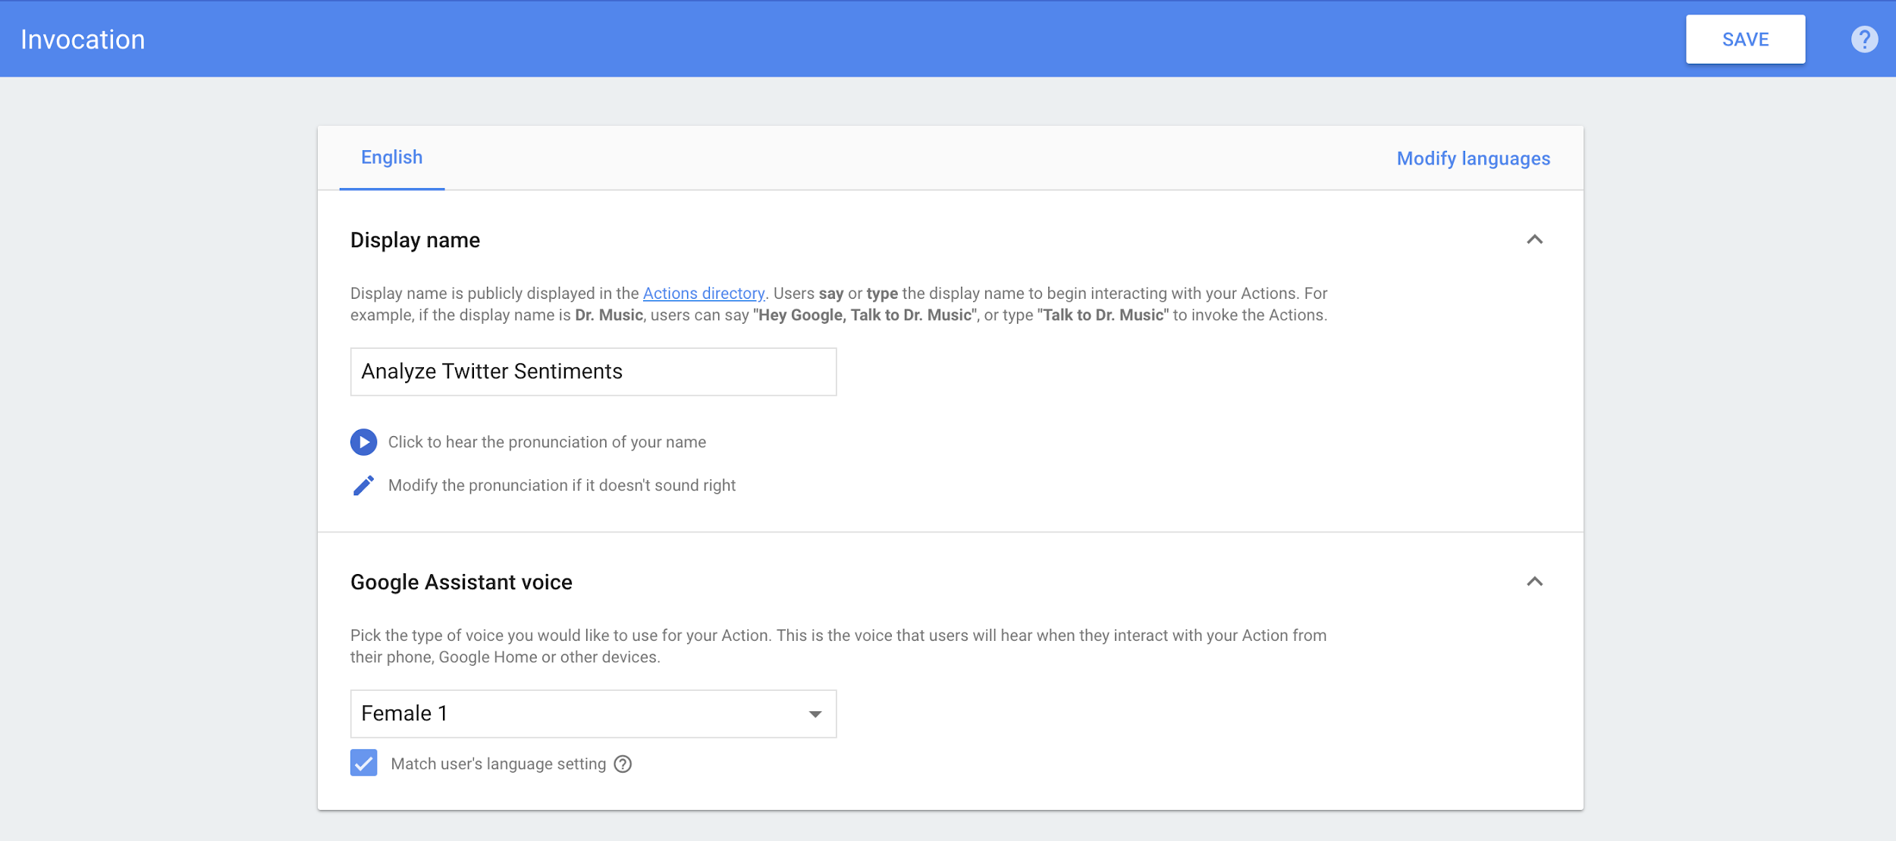
Actions on Google Console
Name your Action.
Choose the Google Assistant voice you'd like your app to use.
Select SAVE. Now, a user will be able to open your Action by saying its name!
Notes:
What to Say:
Explain to participants what they will learn today
Learning is a core part of being a hacker and today they are going to learn something new
What to Do:
Get participants excited about the experience.

Slide 35
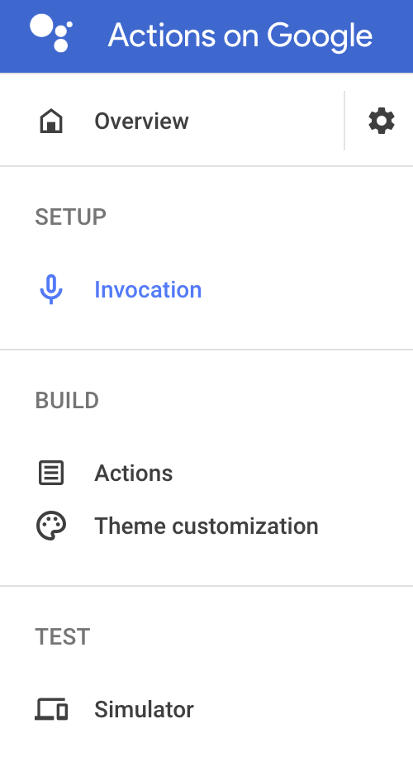
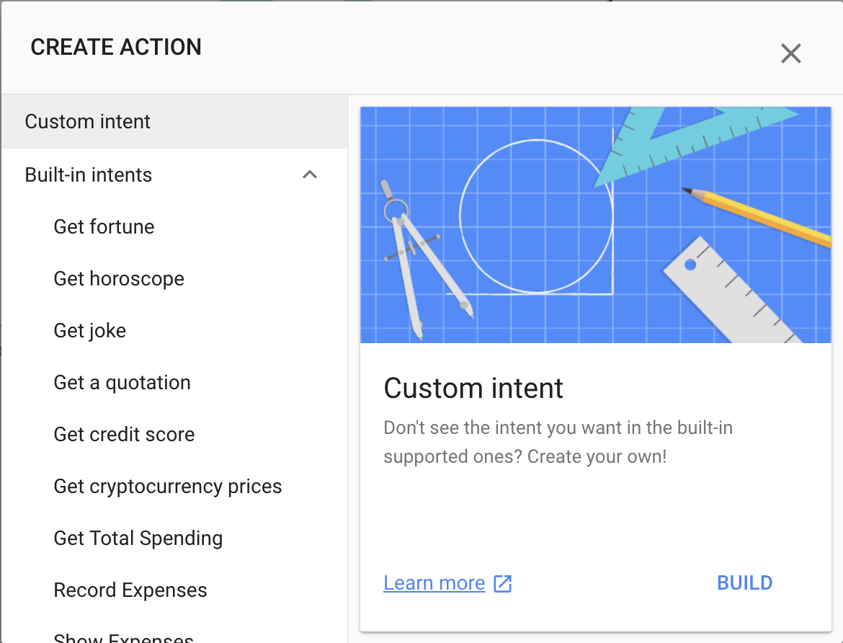
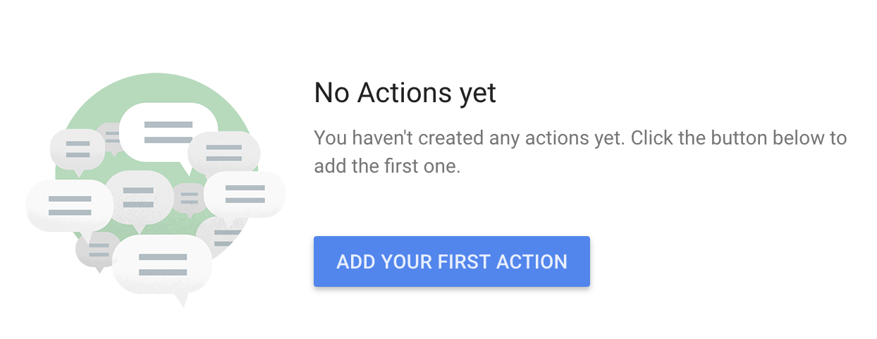
Actions on Google Console
Select Actions on the left to create our action.
Selection ADD YOUR FIRST ACTION.
Select BUILD. This is going to build a custom intent for your Action. An intent is something we want our action to do!
Notes:
What to Say:
Explain to participants what they will learn today
Learning is a core part of being a hacker and today they are going to learn something new
What to Do:
Get participants excited about the experience.

Slide 36
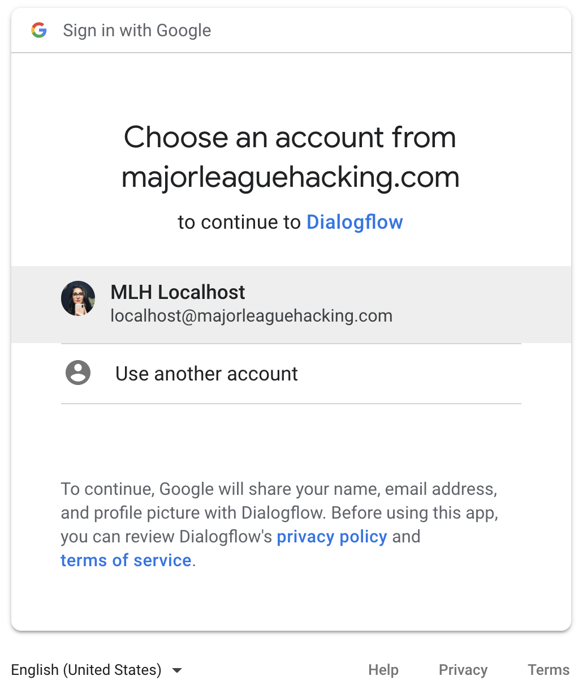
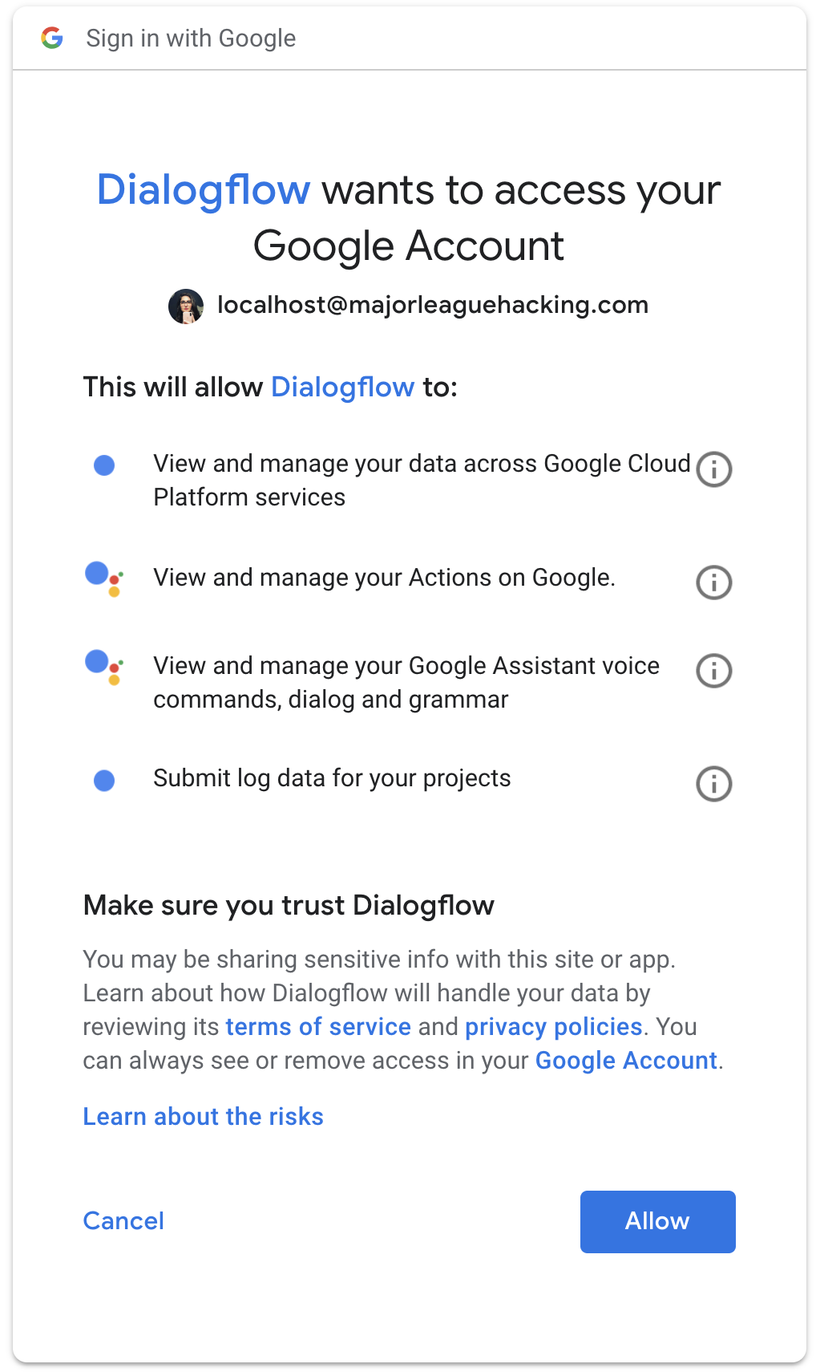
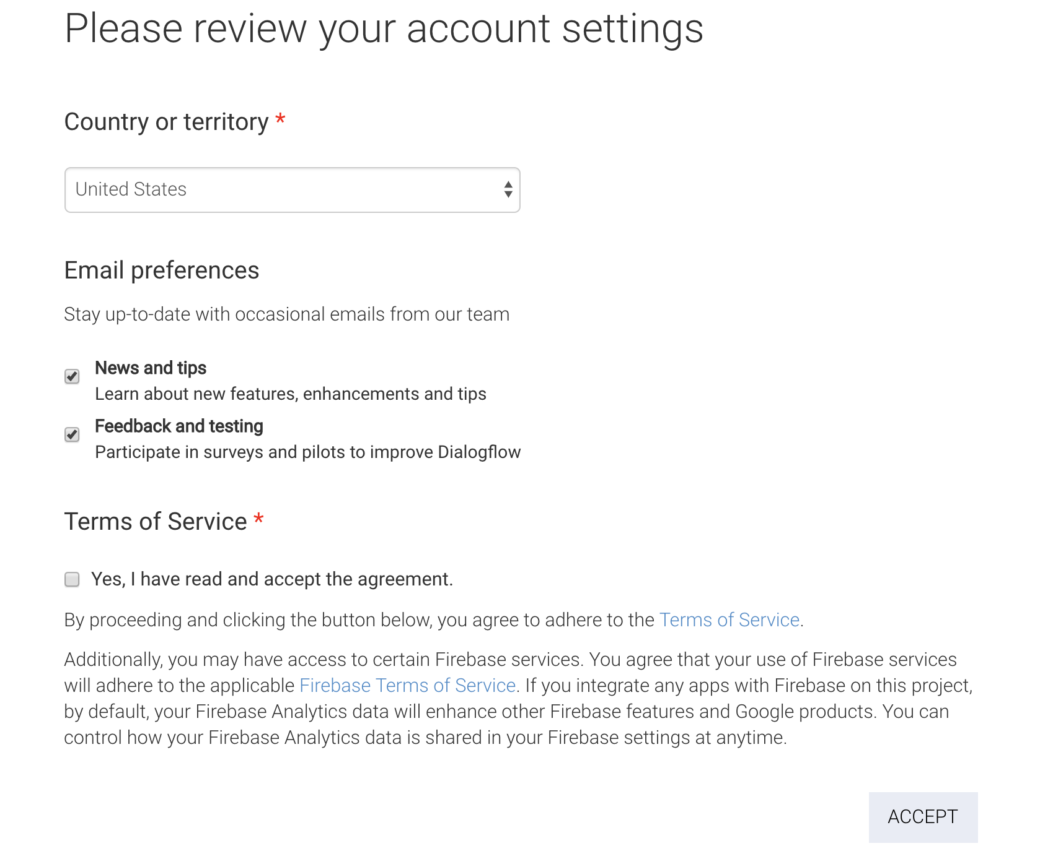
Actions on Google Console
Select the same account you've been using.
Allow Dialogflow to access your Google Account.
Read the terms and check the box if you accept. Select ACCEPT.
Notes:
What to Say:
Explain to participants what they will learn today
Learning is a core part of being a hacker and today they are going to learn something new
What to Do:
Get participants excited about the experience.

Slide 37
Remember, making a cool Action for Google Assistant requires putting together several tools. We're setting up the last one. You can do it!
Notes:
What to Say:
Read the slide.

Slide 38

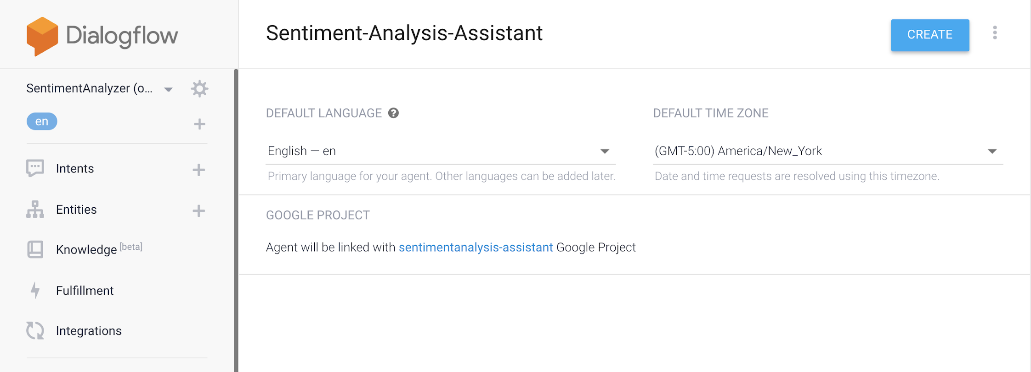
Dialogflow
This is the Dialogflow console. This tool enables you to create the conversational interactions for your Action.
Verify that your Agent will be linked to the correct project.
Select CREATE.
Notes:
What to Say:
Explain to participants what they will learn today
Learning is a core part of being a hacker and today they are going to learn something new
What to Do:
Get participants excited about the experience.

Slide 39
We're going to configure our custom intent next!
Notes:
What to Say:
Read the slide.

Slide 40
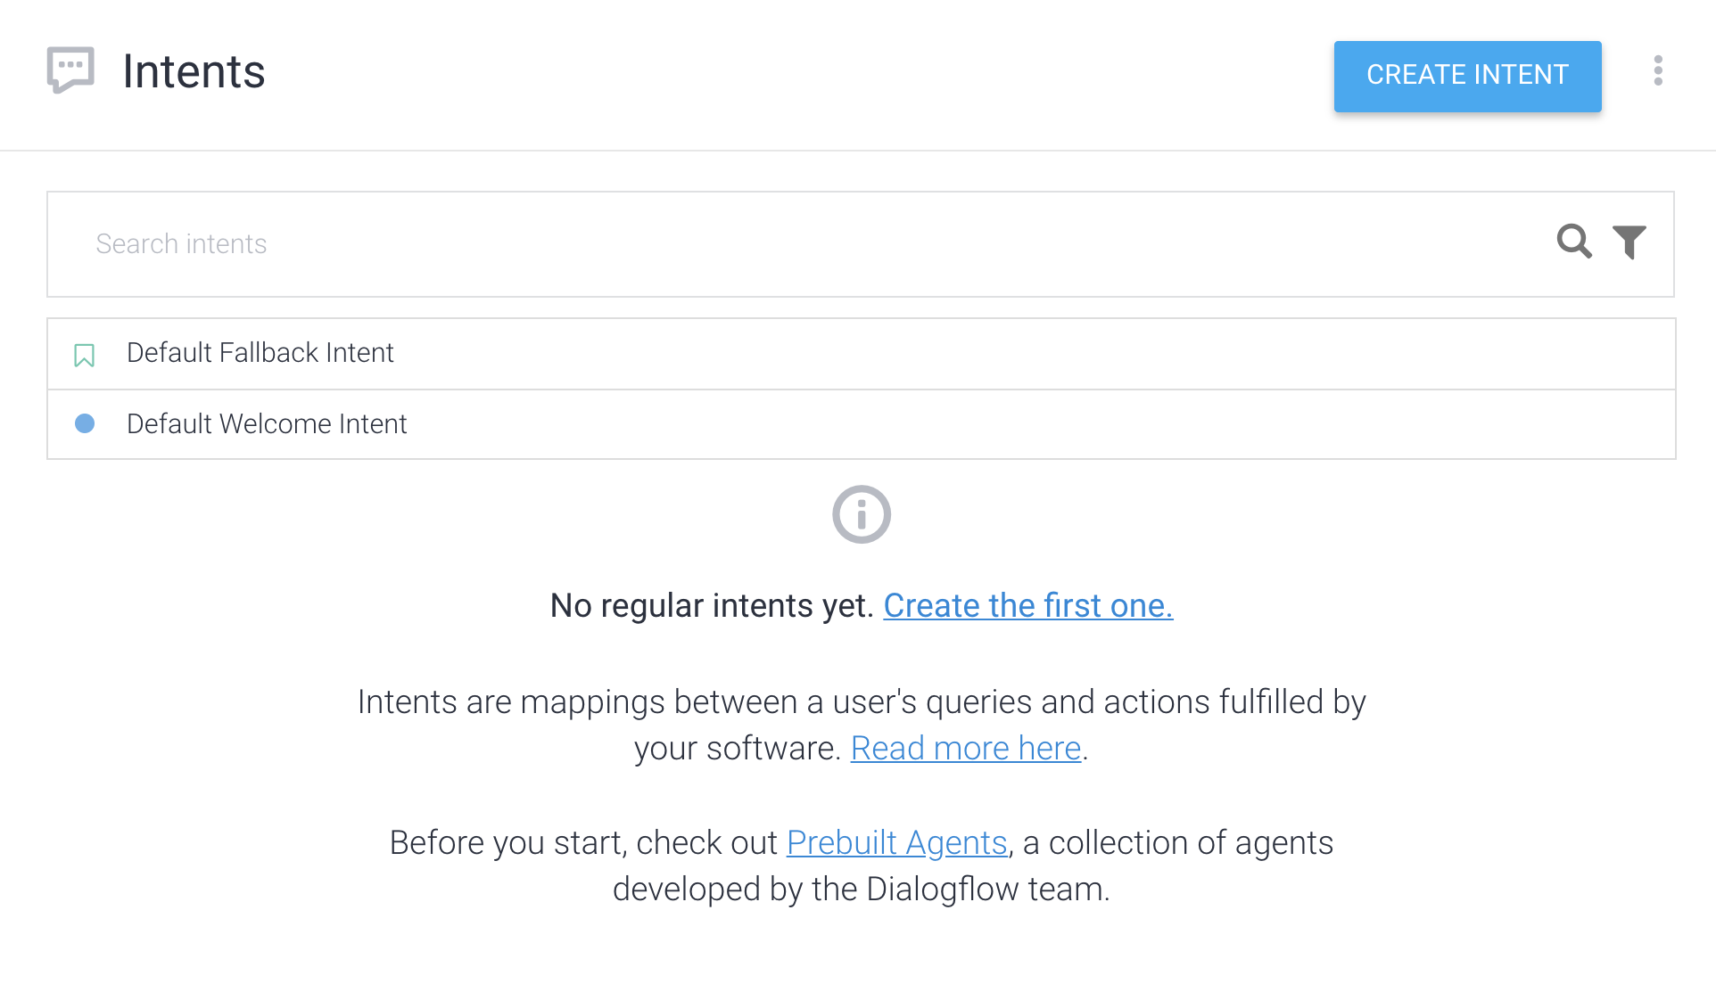
Dialogflow: Create Intent
All Actions have two built in intents - Default Welcome and Default Fallback. These are used for your Action to Welcome users, and for when your Action isn't sure what to do.
Let's add the intent that will enable your users to ask Google Assistant how people feel about something on Twitter!
Notes:
What to Say:
Explain to participants what they will learn today
Learning is a core part of being a hacker and today they are going to learn something new
What to Do:
Get participants excited about the experience.

Slide 41
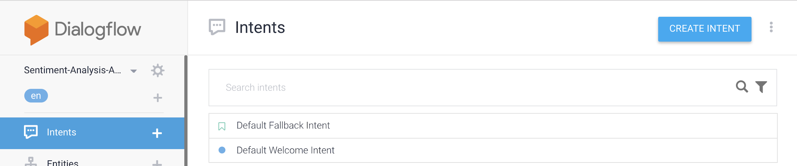
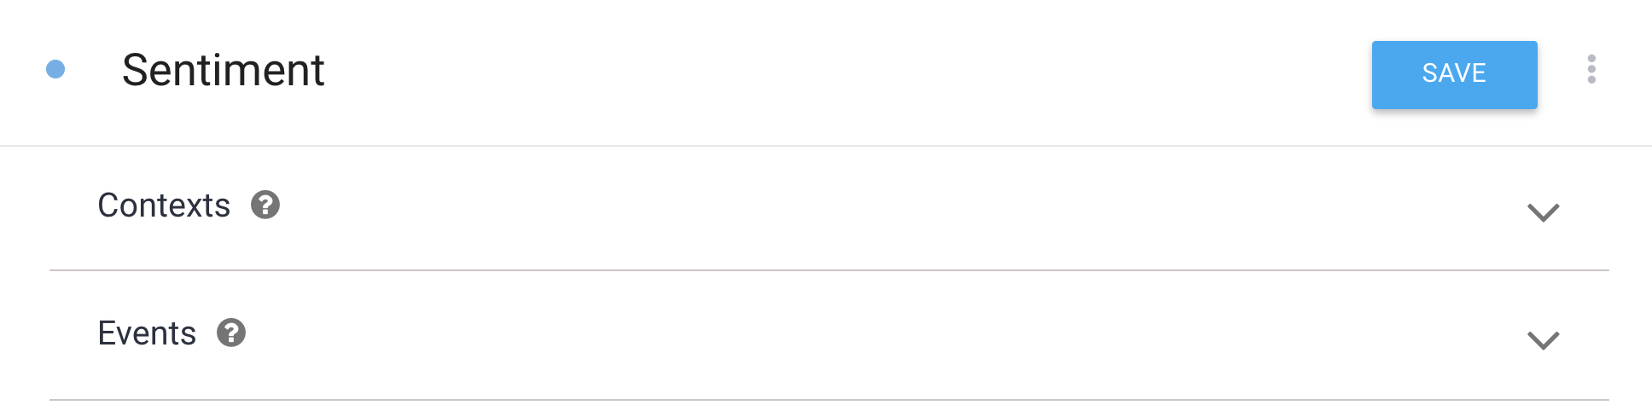
Dialogflow: Create Intent
Select CREATE INTENT.
Name your intent Sentiment and select SAVE.
Notes:
What to Say:
Explain to participants what they will learn today
Learning is a core part of being a hacker and today they are going to learn something new
What to Do:
Get participants excited about the experience.

Slide 42
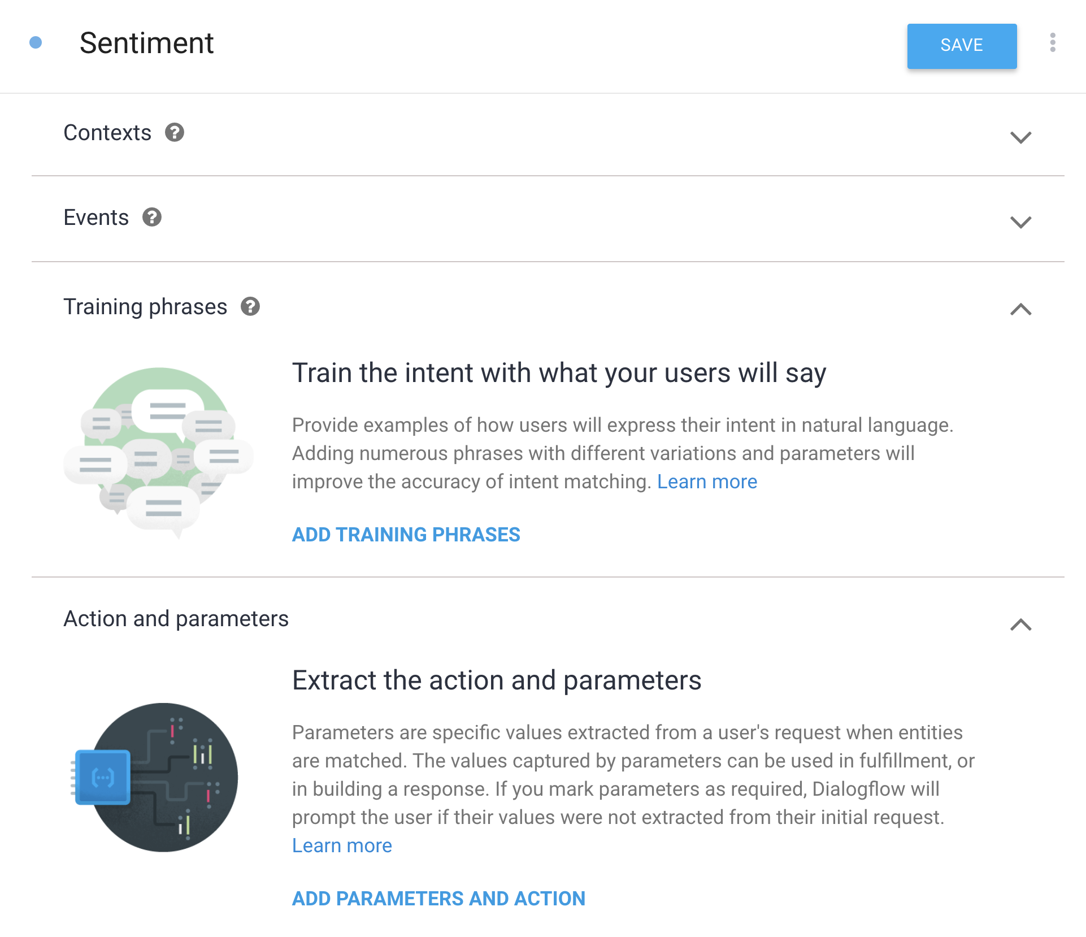
Dialogflow
There are numerous settings we can configure for an intent. We're going to create Training phrases and Responses, and configure Fulfillment.
Notes:
What to Say:
Explain to participants what they will learn today
Learning is a core part of being a hacker and today they are going to learn something new
What to Do:
Get participants excited about the experience.

Slide 43
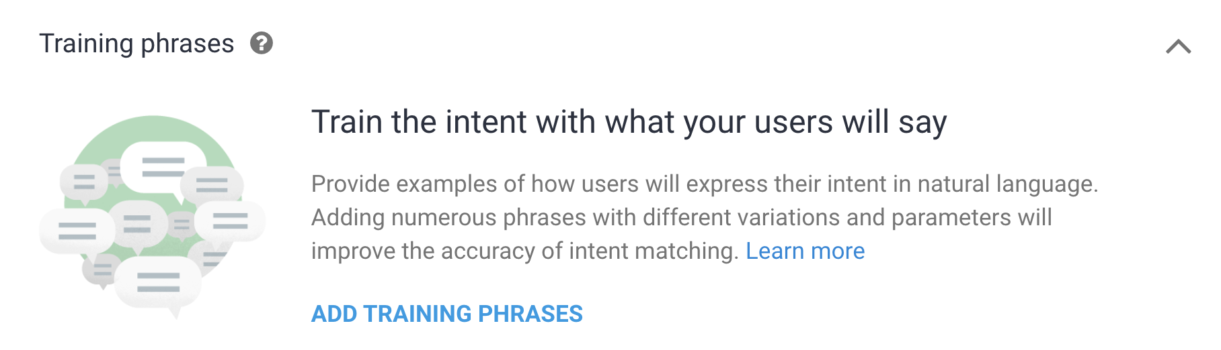
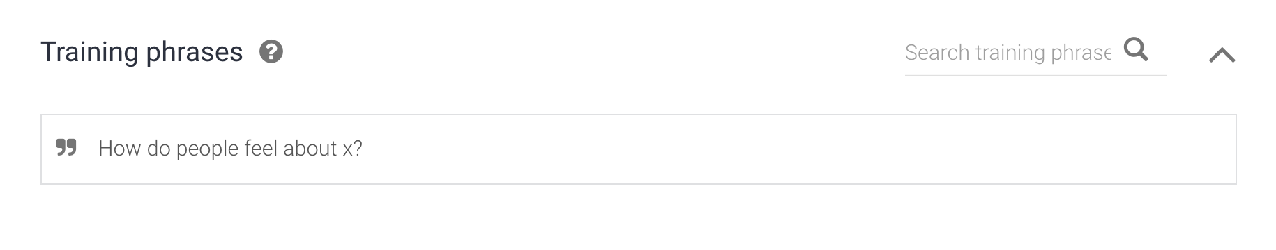
Dialogflow: Training Phrases
Select ADD TRAINING PHRASES. Training phrases are what your users might say to your Action.
Type How do people feel about x? in the Add user expression box.
Notes:
What to Say:
Explain to participants what they will learn today
Learning is a core part of being a hacker and today they are going to learn something new
What to Do:
Get participants excited about the experience.

Slide 44
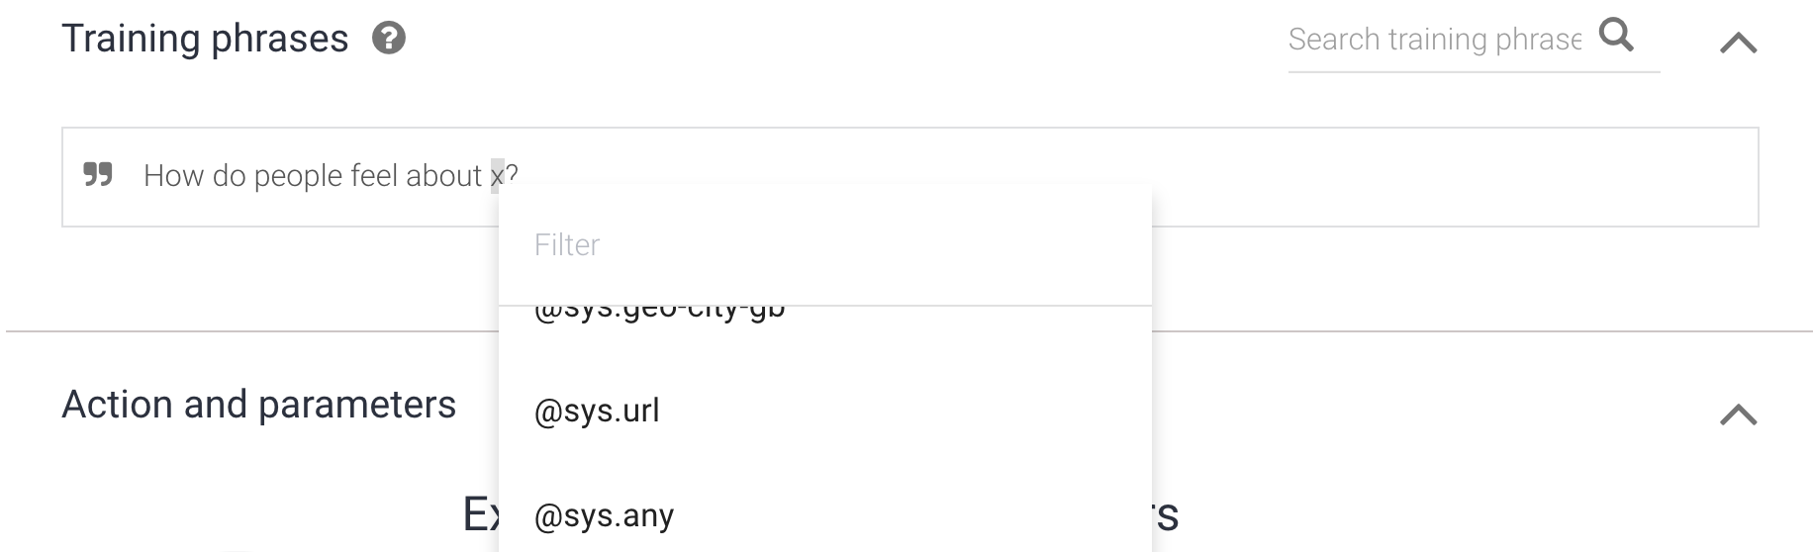
Dialogflow: Training Phrases
Highlight the 'x'. Scroll to @sys.any in the pop up. Save.
We want users to be able to say "How do people feel about (insert whatever topic here)?" So, we turned x into a variable that can represent anything.
Notes:
What to Say:
Explain to participants what they will learn today
Learning is a core part of being a hacker and today they are going to learn something new
What to Do:
Get participants excited about the experience.

Slide 45
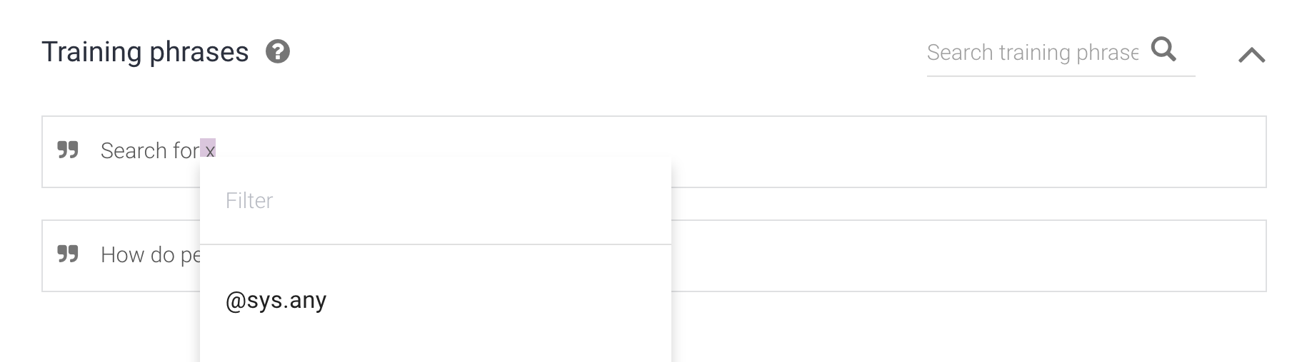
Dialogflow: Training Phrases
We also want users to be able to say "Search for (something)" and have the Action understand. Repeat steps 4 and 5 to add this phrase.
Repeat for 'Search for x.'
Notes:
What to Say:
Explain to participants what they will learn today
Learning is a core part of being a hacker and today they are going to learn something new
What to Do:
Get participants excited about the experience.

Slide 46
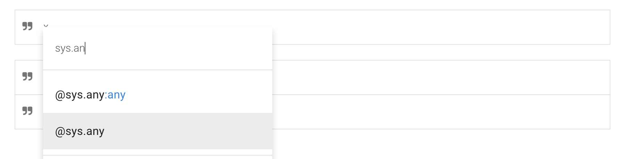
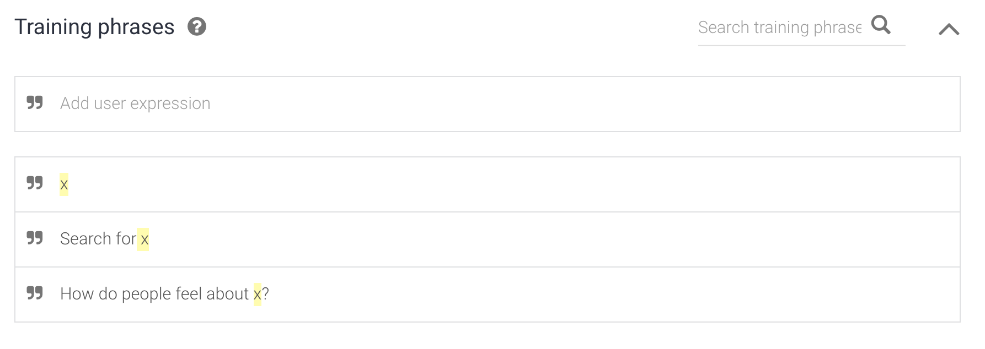
Dialogflow: Training Phrases
Do the same thing for just the phrase "x." This allows users to just say the search term, without any other words. Note: You will need a space after 'x'
You should have three training phrases now!
Notes:
What to Say:
Explain to participants what they will learn today
Learning is a core part of being a hacker and today they are going to learn something new
What to Do:
Get participants excited about the experience.

Slide 47
Training phrases are what users might say to your Action. Let's add some Responses - what your Action will say back!
Notes:
What to Say:
Read the slide.

Slide 48
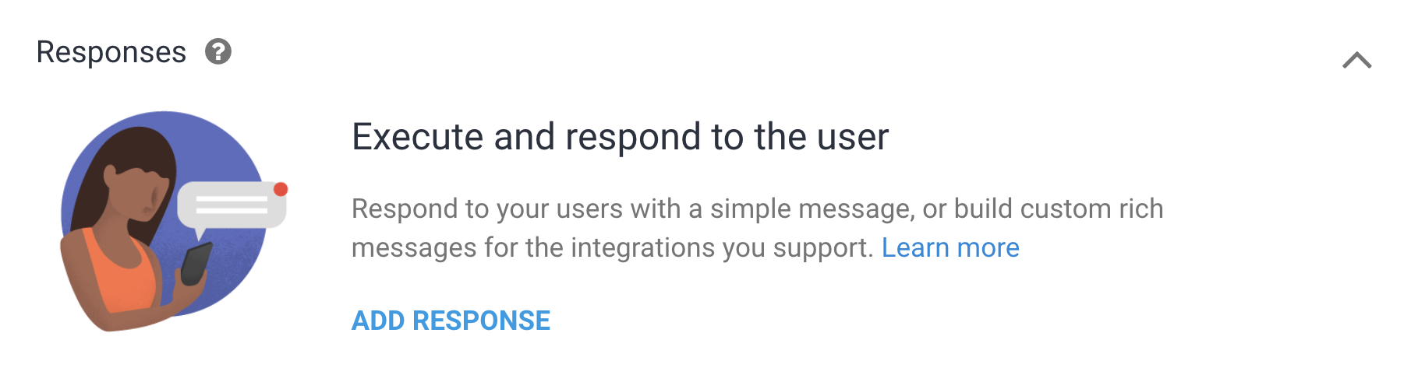
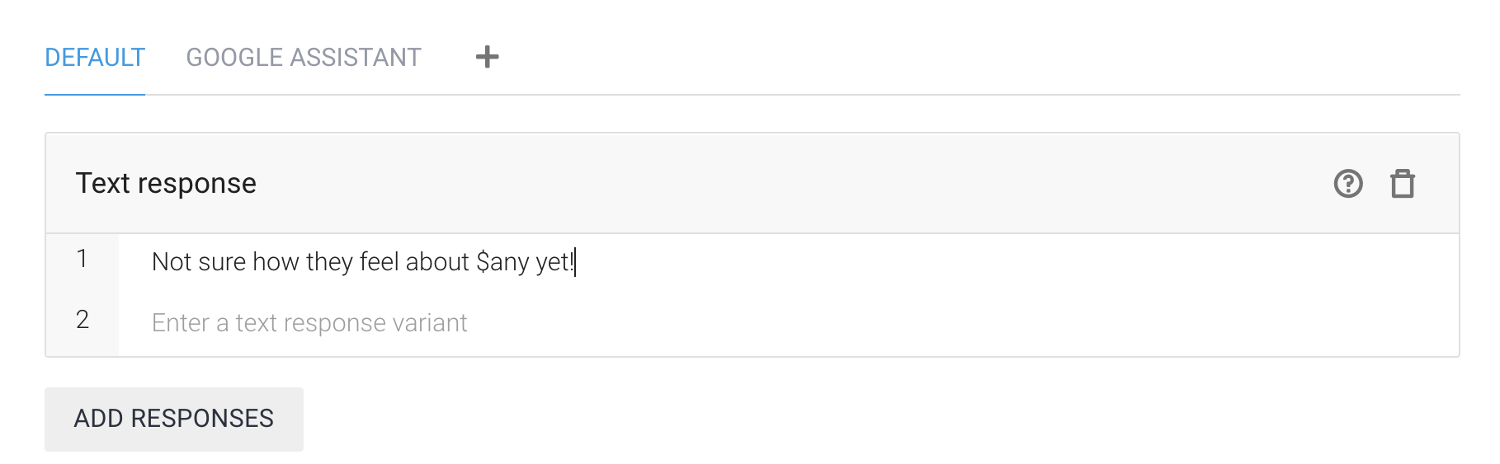
Dialogflow: Responses
Scroll down to Responses and select ADD RESPONSE.
Enter "Not sure how they feel about $any yet!" Be sure to Save. When we explore the code later, we'll learn when the Assistant will use this phrase.
Notes:
What to Say:
Explain to participants what they will learn today
Learning is a core part of being a hacker and today they are going to learn something new
What to Do:
Get participants excited about the experience.

Slide 49
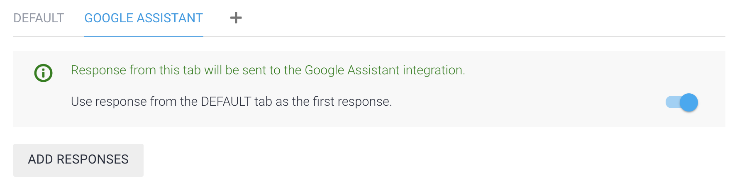
Dialogflow: Responses
Select GOOGLE ASSISTANT and toggle the bar on. Save.
This enabled Google Assistant to use the response you created.
Now, we have to allow a web app to call your Action.
Notes:
What to Say:
Explain to participants what they will learn today
Learning is a core part of being a hacker and today they are going to learn something new
What to Do:
Get participants excited about the experience.

Slide 50
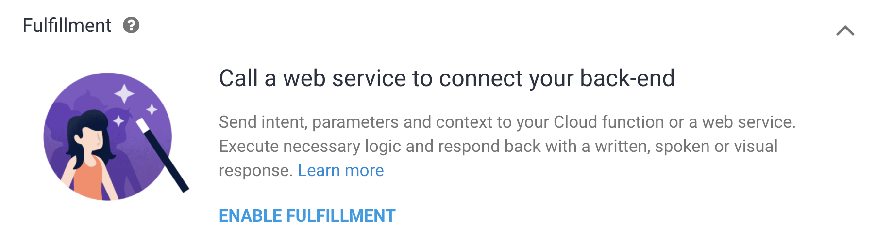
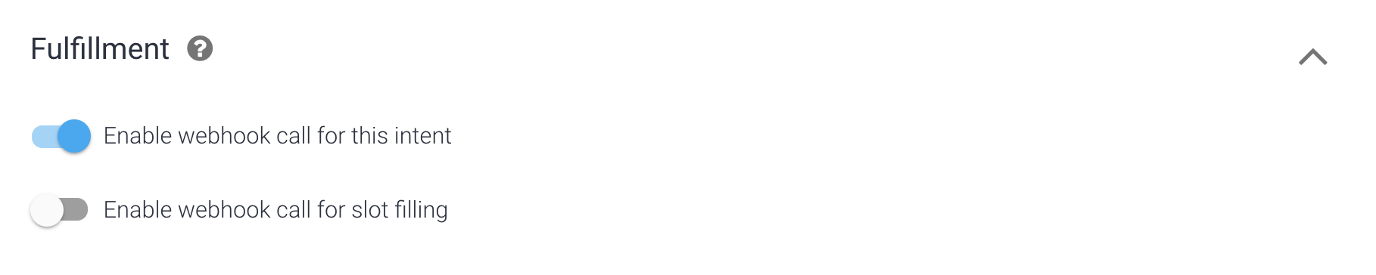
Dialogflow: Fulfillment
Select Fulfillment on the bottom of the Intents page. Select ENABLE FULFILLMENT.
Toggle on Enable webhook call for this intent. Save at the top of the page.
Notes:
What to Say:
Explain to participants what they will learn today
Learning is a core part of being a hacker and today they are going to learn something new
What to Do:
Get participants excited about the experience.

Slide 51
You just designed the conversation interaction for your Action! Now, users can ask your Action how people feel about a certain topic.
We need to add the code so your Action can receive and handle these incoming requests.
Notes:
What to Say:
Read the slide.

Slide 53
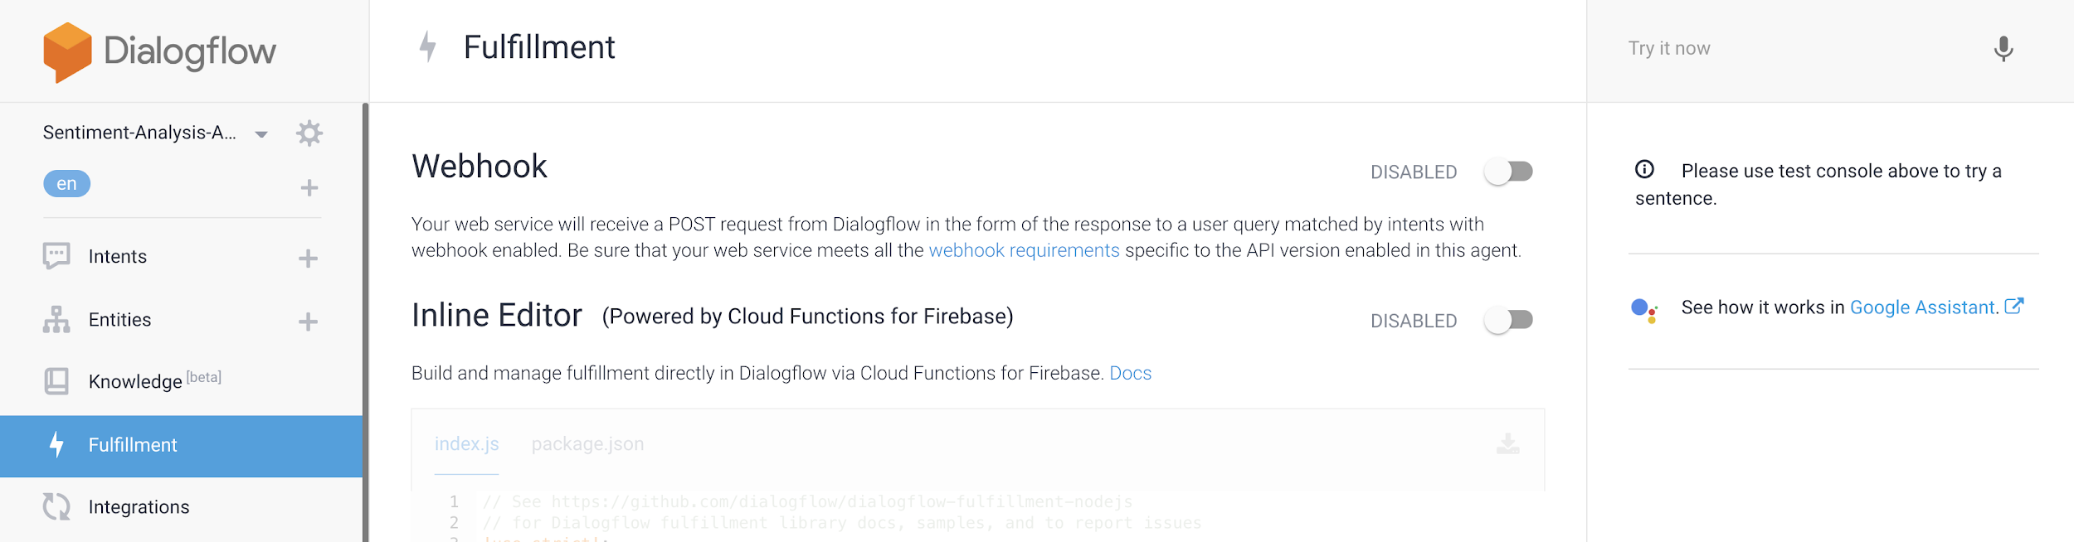
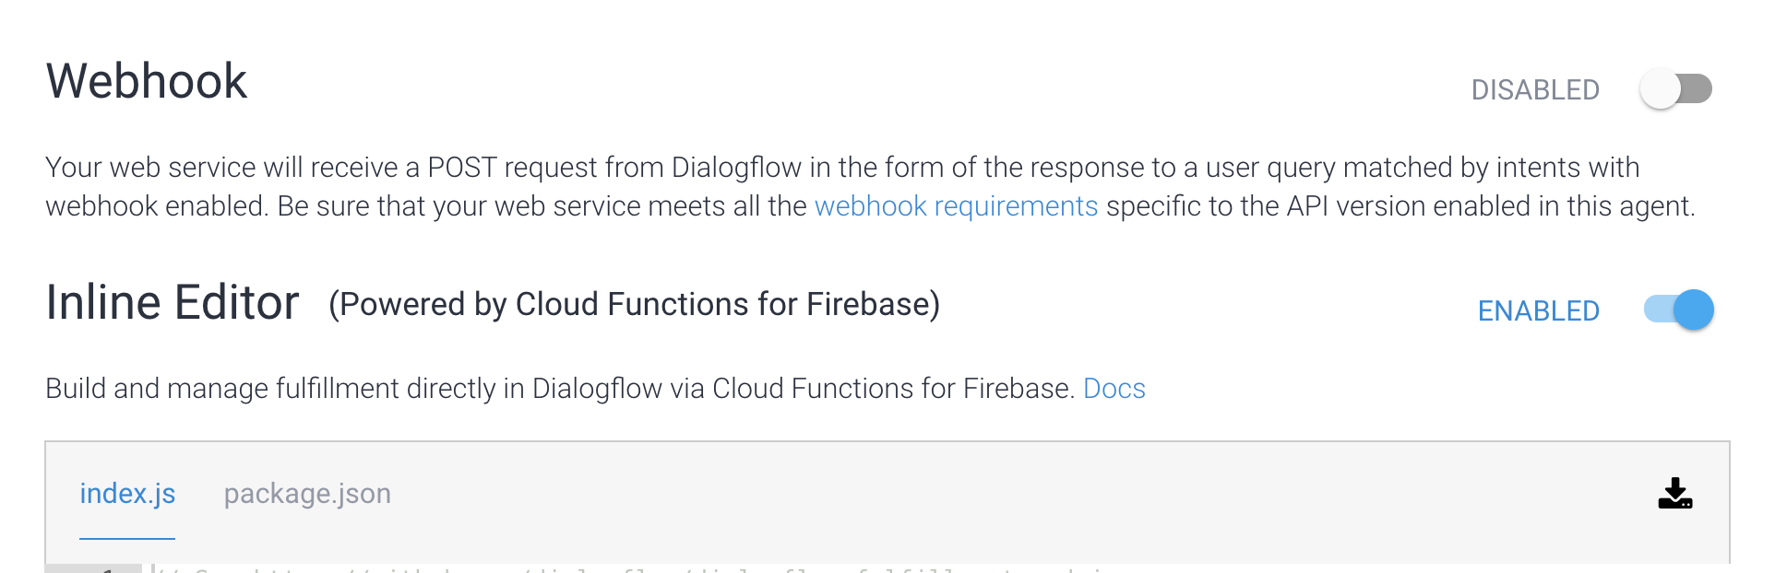
Dialogflow: Fulfillment
On the left side of the page, click Fulfillment.
Enable the Inline Editor.
Notes:
What to Say:
Explain to participants what they will learn today
Learning is a core part of being a hacker and today they are going to learn something new
What to Do:
Get participants excited about the experience.

Slide 54
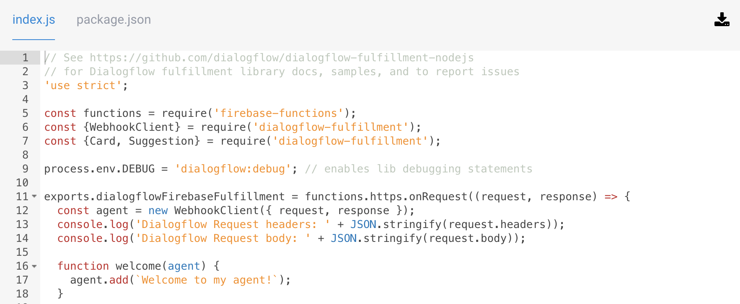
Dialogflow: Fulfillment
There are two files required for an Action - index.js and package.json. We're going to replace the default ones with our own code. Let's get that code!
Notes:
What to Say:
Explain to participants what they will learn today
Learning is a core part of being a hacker and today they are going to learn something new
What to Do:
Get participants excited about the experience.

Slide 55
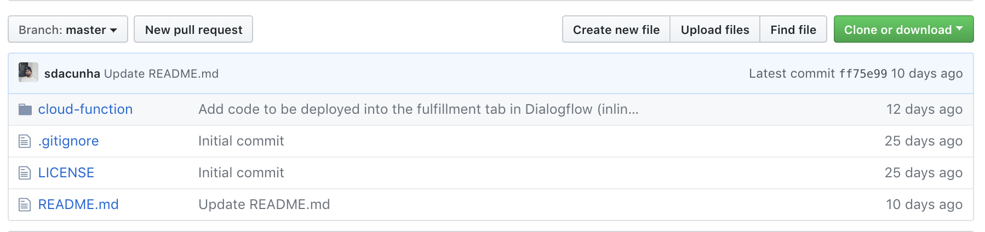
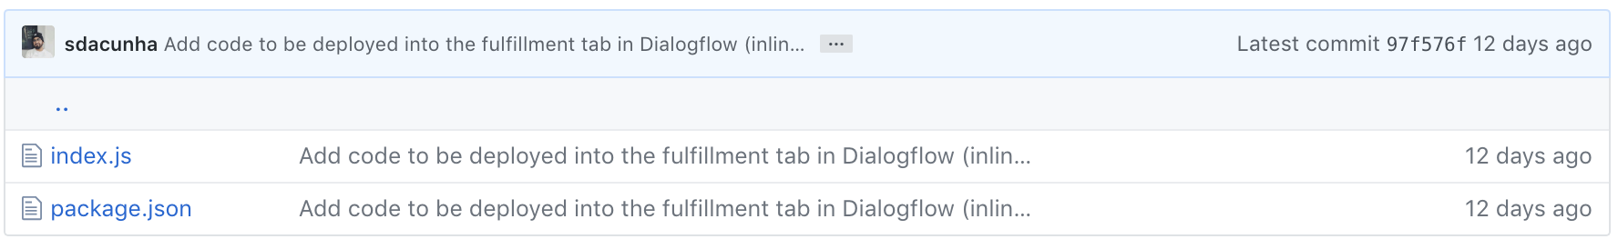
Add the Code: index.js
Check your email to find the URL for the code. Select cloud-function/ then index.js.
Notes:
What to Say:
Explain to participants what they will learn today
Learning is a core part of being a hacker and today they are going to learn something new
What to Do:
Get participants excited about the experience.

Slide 56
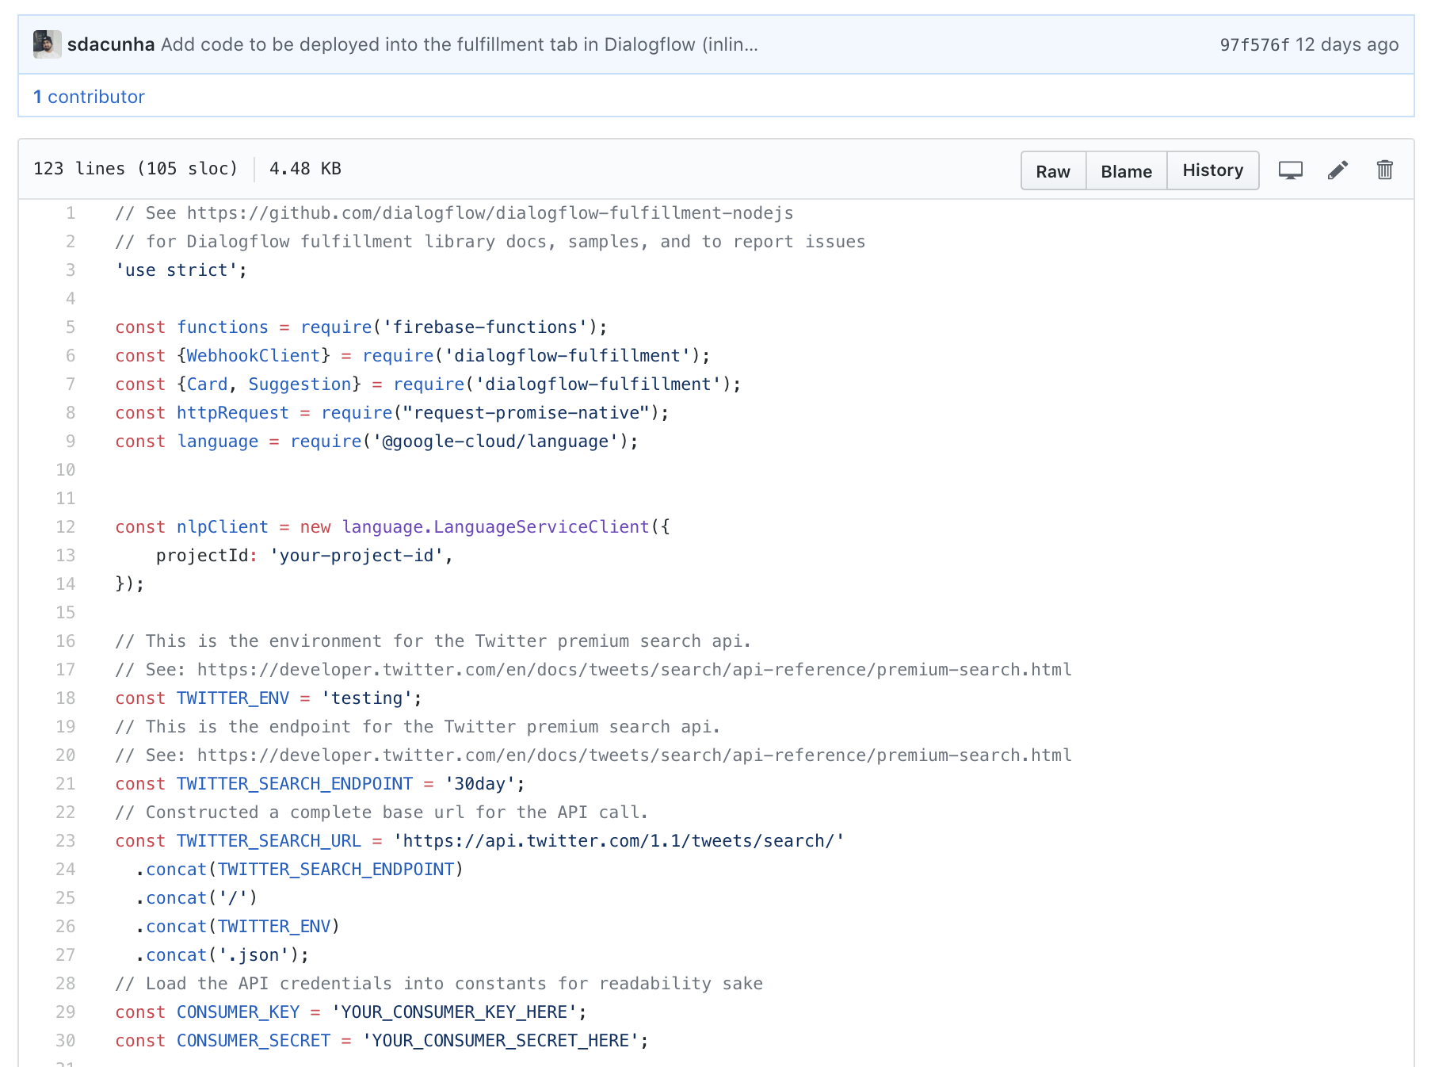
Add the Code: index.js
Copy everything from index.js.
Notes:
What to Say:
Explain to participants what they will learn today
Learning is a core part of being a hacker and today they are going to learn something new
What to Do:
Get participants excited about the experience.

Slide 57
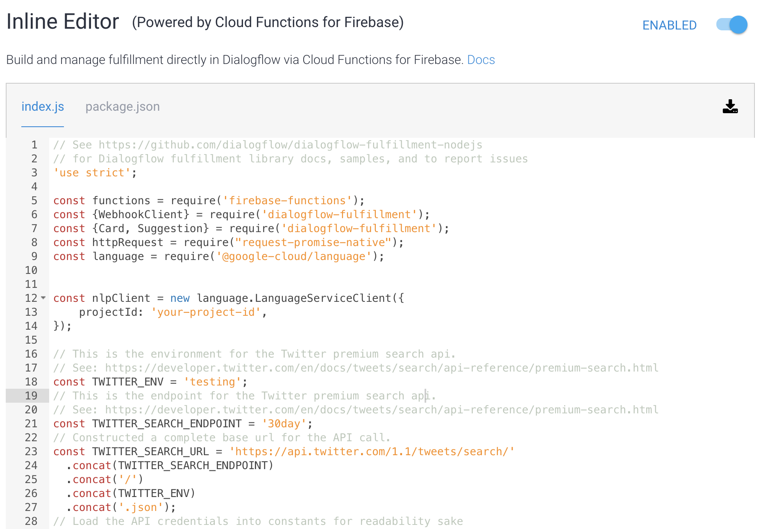
Add the Code: index.js
Replace index.js in the Dialogflow editor with the code you just copied.
Notes:
What to Say:
Explain to participants what they will learn today
Learning is a core part of being a hacker and today they are going to learn something new
What to Do:
Get participants excited about the experience.

Slide 58
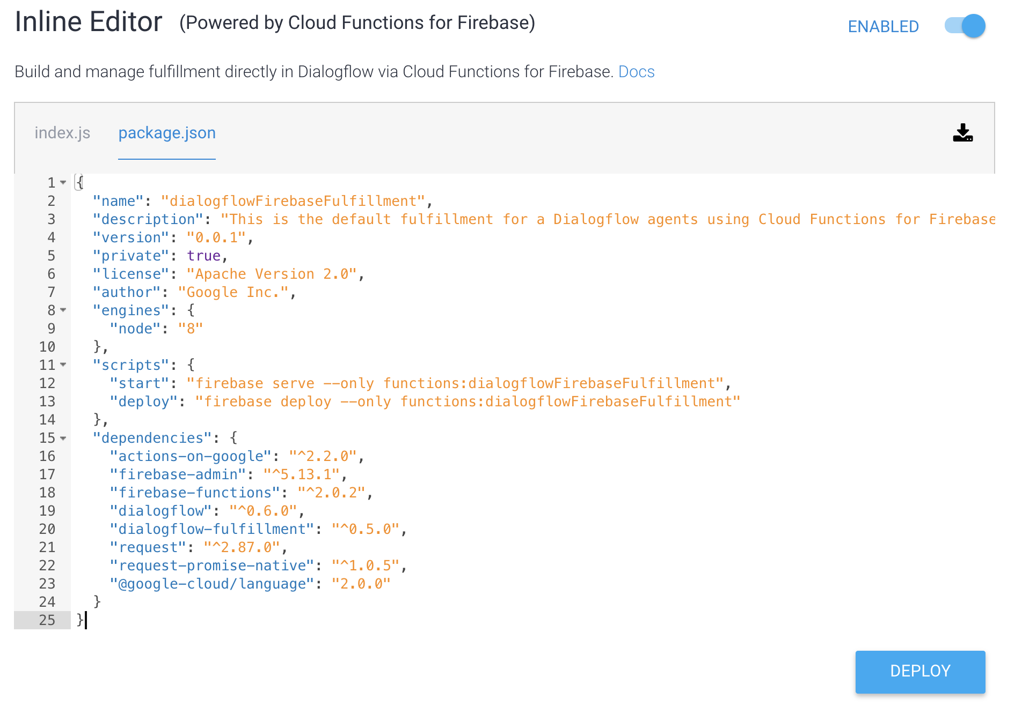
Add the Code: package.json
Repeat the previous steps to replace package.json with the contents of package.json from GitHub.
Notes:
What to Say:
Explain to participants what they will learn today
Learning is a core part of being a hacker and today they are going to learn something new
What to Do:
Get participants excited about the experience.

Slide 59
Now that you've added the code to your Action, let's dive into the code to understand what it does!
Notes:
What to Say:
Read the slide.

Slide 60

Code Review
The app that our Action will use to manage incoming and outgoing requests is a Node.js app. This app uses several Node packages to make development easier.
index.js
Line 5 allows our Action to use firebase-functions
Line 6 allows our Action to use google-cloud/language
Line 7 allows our Action to use JavaScript promises
Line 8 allows our Action to use the the actions-on-google library
Notes:
https://www.npmjs.com/package/@google-cloud/language

Slide 61

Code Review
index.js
Line 11 creates a new instance of the Dialogflow app.
Lines 13 - 15 create an instance of the Natural Language Service client. It requires your project ID to work. Let's get that now!
Notes:
What to Say:
Explain to participants what they will learn today
Learning is a core part of being a hacker and today they are going to learn something new
What to Do:
Get participants excited about the experience.

Slide 62

Get Project ID
In another browser window (don't close the one with your code), return to console.cloud.google.com. Copy your Project ID. If you have multiple GCP projects, make sure you're viewing the right one.
Notes:
What to Say:
Explain to participants what they will learn today
Learning is a core part of being a hacker and today they are going to learn something new
What to Do:
Get participants excited about the experience.

Slide 63
Get Project ID
Back in the code editor, paste your Project ID into line 14. This connects your code to the correct project. Now, back to the review!
Notes:
What to Say:
Explain to participants what they will learn today
Learning is a core part of being a hacker and today they are going to learn something new
What to Do:
Get participants excited about the experience.

Slide 64

Code Review
index.js
Remember that our Action runs sentiment analysis on tweets. To be able to do that, we need to use the Twitter API to pull tweets. This code allows us to make requests to the Twitter API. API calls require a consumer key and a consumer secret. Let's get those now!
Notes:
What to Say:
Explain to participants what they will learn today
Learning is a core part of being a hacker and today they are going to learn something new
What to Do:
Get participants excited about the experience.

Slide 65
Remember, you're an architect! This is another part of the structure.
Notes:
What to Say:
Read the slide.

Slide 66

Make a Twitter Developer Account
Use an existing Twitter account or create a new Twitter account.
Then, go to developer.twitter.com and select Apply.
Click Apply for a developer account >
Notes:
What to Say:
Explain to participants what they will learn today
Learning is a core part of being a hacker and today they are going to learn something new
What to Do:
Get participants excited about the experience.

Slide 67

Make a Twitter Developer Account
Authorize your account. If you agree to the terms, select Continue.
Notes:
What to Say:
Explain to participants what they will learn today
Learning is a core part of being a hacker and today they are going to learn something new
What to Do:
Get participants excited about the experience.

Slide 68


Make a Twitter Developer Account
Select relevant use cases for your app.
Fill out the description of your app. You must be detailed to be approved.
Select No, then Continue.
Notes:
What to Say:
Explain to participants what they will learn today
Learning is a core part of being a hacker and today they are going to learn something new
What to Do:
Get participants excited about the experience.

Slide 69

Make a Twitter Developer Account
Read the terms of service, and if you agree check the first box.
Then click Submit application.
Notes:
What to Say:
Explain to participants what they will learn today
Learning is a core part of being a hacker and today they are going to learn something new
What to Do:
Get participants excited about the experience.

Slide 70

Make a Twitter Developer Account
Check your email and click the verification email.
Notes:
What to Say:
Explain to participants what they will learn today
Learning is a core part of being a hacker and today they are going to learn something new
What to Do:
Get participants excited about the experience.

Slide 71


Make a Twitter Developer Account
Once you confirm your email, you'll be redirected. Click Create an app.
Then, click Create an app.
Notes:
What to Say:
Explain to participants what they will learn today
Learning is a core part of being a hacker and today they are going to learn something new
What to Do:
Get participants excited about the experience.

Slide 72


Make a Twitter Developer Account
Name your app.
Describe how your app will be used, then click Create.
Notes:
What to Say:
Explain to participants what they will learn today
Learning is a core part of being a hacker and today they are going to learn something new
What to Do:
Get participants excited about the experience.

Slide 73

Make a Twitter Developer Account
Click Create!
Notes:
What to Say:
Explain to participants what they will learn today
Learning is a core part of being a hacker and today they are going to learn something new
What to Do:
Get participants excited about the experience.

Slide 74
Okay! You got your Twitter developer account up and running. Now you need to grab your API credentials and head back to Google Cloud Platform.
Notes:
What to Say:
Read the slide.

Slide 75

Get Twitter Credentials
Select Keys and tokens.
Copy your API key, then return to Dialogflow (where your code is).
Notes:
What to Say:
Explain to participants what they will learn today
Learning is a core part of being a hacker and today they are going to learn something new
What to Do:
Get participants excited about the experience.

Slide 76

Get Twitter Credentials
Paste your API key on line 29.
Repeat the process for API secret key.
Notes:
What to Say:
Explain to participants what they will learn today
Learning is a core part of being a hacker and today they are going to learn something new
What to Do:
Get participants excited about the experience.

Slide 77
One last step with the Twitter API - you need to set up an app environment.
Notes:
What to Say:
Read the slide.

Slide 78


Twitter Dev Environment
In the upper right hand corner, select your username, then select Dev Environments from the drop down.
Select Set up dev environment under Search Tweets: 30-Days/Sandbox
Notes:
What to Say:
Explain to participants what they will learn today
Learning is a core part of being a hacker and today they are going to learn something new
What to Do:
Get participants excited about the experience.

Slide 79

Twitter Dev Environment
Name this Dev environment testing.
Select your app from the drop down.
Select Complete setup.
Notes:
What to Say:
Explain to participants what they will learn today
Learning is a core part of being a hacker and today they are going to learn something new
What to Do:
Get participants excited about the experience.

Slide 80
Twitter Dev Environment
Back in the code editor in Dialogflow, notice that on Line 18, the TWITTER_ENV constant has the value testing. We don't need to change anything because that's what we named the Twitter Dev environment!
Notes:
What to Say:
Explain to participants what they will learn today
Learning is a core part of being a hacker and today they are going to learn something new
What to Do:
Get participants excited about the experience.

Slide 81
Before we finish the code review, let's take a quick pause to review what we've done here.
Notes:
What to Say:
Read the slide.

Slide 82
What have we done so far?
Action We Took
What It Does for the Action
1. Created a GCP Account
1. This hosts your project
2. Created an Action on Google
2. Allows us to create an Action for Google Assistant
3. Set up Dialogflow
3. Allowed us to configure conversational interactions for our Action
4. Created a Twitter Developer Account
4. This enables us to use the Twitter API
5. Added Twitter credentials to the code
5. This lets our Action communicate with the Twitter API
Notes:
What to Say:
Explain to participants what they will learn today
Learning is a core part of being a hacker and today they are going to learn something new
What to Do:
Get participants excited about the experience.

Slide 83
Okay, now that you have reviewed all the steps we've taken so far, let's finish reviewing this code!
Notes:
What to Say:
Read the slide.

Slide 84

Code Review
index.js
Lines 43-50 define a helper function that removes all retweets from the search results and saves them to an array. We used this function earlier.
Notes:
What to Say:
Explain to participants what they will learn today
Learning is a core part of being a hacker and today they are going to learn something new
What to Do:
Get participants excited about the experience.

Slide 85

Code Review
index.js
Lines 58-64 define a helper function that extracts all the tweets from the API response and saves them to an array.
Notes:
What to Say:
Explain to participants what they will learn today
Learning is a core part of being a hacker and today they are going to learn something new
What to Do:
Get participants excited about the experience.

Slide 86

Code Review
index.js
Line 67 calls the intent method on our app. It passes the name of the intent we created - Sentiment - and two params.
Lines 68 sets the input equal to params.any (remember when we set up @any?)
Lines 70-77 make a request to the Twitter API using what the user said to our Action and our API credentials.

Slide 87
Code Review
index.js
Line 80 makes the request and returns the response.
Line 82 removes all the retweets from the response from Twitter. This means we're only getting each tweet one time.
Notes:
What to Say:
Explain to participants what they will learn today
Learning is a core part of being a hacker and today they are going to learn something new
What to Do:
Get participants excited about the experience.

Slide 88

Code Review
index.js
Lines 85-89 submits the response from Twitter to the Natural Language Processing API.
Notes:
What to Say:
Explain to participants what they will learn today
Learning is a core part of being a hacker and today they are going to learn something new
What to Do:
Get participants excited about the experience.

Slide 89
Code Review
index.js
Line 90 The NLP returns a sentiment score (results), which we save to a variable.
Notes:
What to Say:
Explain to participants what they will learn today
Learning is a core part of being a hacker and today they are going to learn something new
What to Do:
Get participants excited about the experience.

Slide 90
Code Review
index.js
Lines 91 - 100 return a response from our Action based on whether the score from the NLP API is positive or negative. conv.close ends the conversation each time the Action responds.
Notes:
What to Say:
Explain to participants what they will learn today
Learning is a core part of being a hacker and today they are going to learn something new
What to Do:
Get participants excited about the experience.

Slide 91
Now you understand how the Action works - let's test it out!
Notes:
What to Say:
Read the slide.

Slide 92

Test your Action
Select Deploy at the bottom of the page. Wait for your Action to deploy.
On the left side of the page click Integrations then INTEGRATION SETTINGS.
Notes:
What to Say:
Explain to participants what they will learn today
Learning is a core part of being a hacker and today they are going to learn something new
What to Do:
Get participants excited about the experience.

Slide 93

Test your Action
Click into the field that says Add intent under Implicit Invocation.
A drop-down containing the name of the Intent you created should appear. Select it.
Click TEST and you will be taken to the Simulator.
Notes:
What to Say:
Explain to participants what they will learn today
Learning is a core part of being a hacker and today they are going to learn something new
What to Do:
Get participants excited about the experience.

Slide 94

Test it out!
The Google Assistant Simulator is a really useful tool to test, debug, and refine your Action. Notice at the bottom of the screen, there is suggested input. This is the invocation you set up at the beginning of the workshop. By saying this, you'll telling Google Assistant which Action you want to use. Type this input or click the microphone and speak the input to invoke (start) your Action.
Notes:
What to Say:
Explain to participants what they will learn today
Learning is a core part of being a hacker and today they are going to learn something new
What to Do:
Get participants excited about the experience.

Slide 95

Test it out!
Google Assistant will respond. Now, type or ask out loud how people feel about a given topic. The response should appear!
Notes:
What to Say:
Explain to participants what they will learn today
Learning is a core part of being a hacker and today they are going to learn something new
What to Do:
Get participants excited about the experience.

Slide 96
You did it!
Notes:
What to Say:
Read the slide.

Slide 98
Let's Recap
What did you learn today:
How to combine Dialogflow and Actions on Google to create conversational interactions
1
2
How to use Natural Language Processing on Tweets
3
Cool uses for Google Cloud Platform!

Slide 99
What did you learn today?
We created a fun quiz to test your knowledge and see what you learned from this workshop.
http://mlhlocal.host/quiz
Notes:
What to Say:
Read the slide.
What to Do:
Get participants excited about taking the quiz. Encourage them all to take it, and pass out stickers to participants who earn 100s. Also encourage participants to take the survey - let them know that Localhost takes their feedback very seriously and we use their feedback to make the workshop better for future participants.

Slide 101
Next Steps
Where to go from here...
General Documentation for Actions: mlhlocal.host/actions-documentation
1
2
Cloud Documentation: mlhlocal.host/gcp-documentation
3
Run your own MLH Localhost Module!

Slide 102
Keep Learning: Practice Problems for Later
Extra Practice Problem 1:
Make the responses returned by the program vary more than "positive," "neutral," or "negative."
Extra Practice Problem 2:
Embed your Action into a web page!

Slide 103
v.0.0.1

